Slide 2
Honor Walk
Stony Brook Medicine
101 Nicolls Road Stony Brook, NY 11794
Amanda Fortuna, BS
Kathleen Glen, LCSW

Slide 3

HONOR WALK
What is it?
When a patient or a patient’s family agrees to organ donation, hospital employees – from all disciplines– quietly line the hallway to honor the donor as they are brought to the operating room.
..

Slide 4
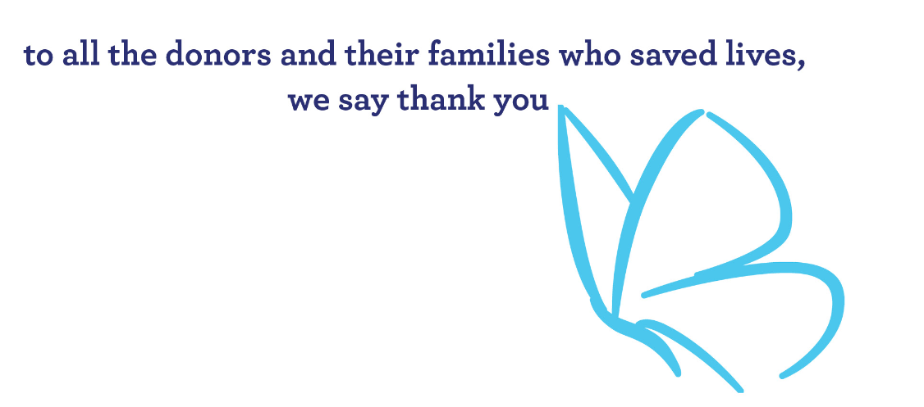
HONOR WALK
Why do this?
Preparing to say goodbye to a loved one is one of the hardest things a person can do.
For a donor family, the loneliest walk they will likely ever take is the one accompanying their loved one from the Intensive Care Unit to the Operating Room to become a donor.
..

Slide 5
HONOR WALK
How did this get started?
Presented to the Donor Council
Garnered support from hospital administration
Collaborated with LIVE ON NY
Developed a process map
..

Slide 7
HONOR WALK
Our First Honor Walk:
A young male who's family gave the gift of organ donation
Obtained leadership support
Coordinated an OR time for 4AM
Administrator and Donor Council member informed staff on all units of pending honor walk and provided instructions at 2AM
Checked and cleared hallways
Coordinated patient elevator
Staff was organized along route to operating room at 3:45AM
Honor walk initiated at 4AM
..

Slide 8
HONOR WALK
Outcome:
Over 100 employees came to show respect, and bow their heads as the family walked their loved one to the Operating Room
Overwhelming feeling of respect and deep appreciation for the donor and family
Supported the donor’s care team
Honored the donor and the donor’s family
Outpouring of pride from hospital staff and community
..

Slide 9
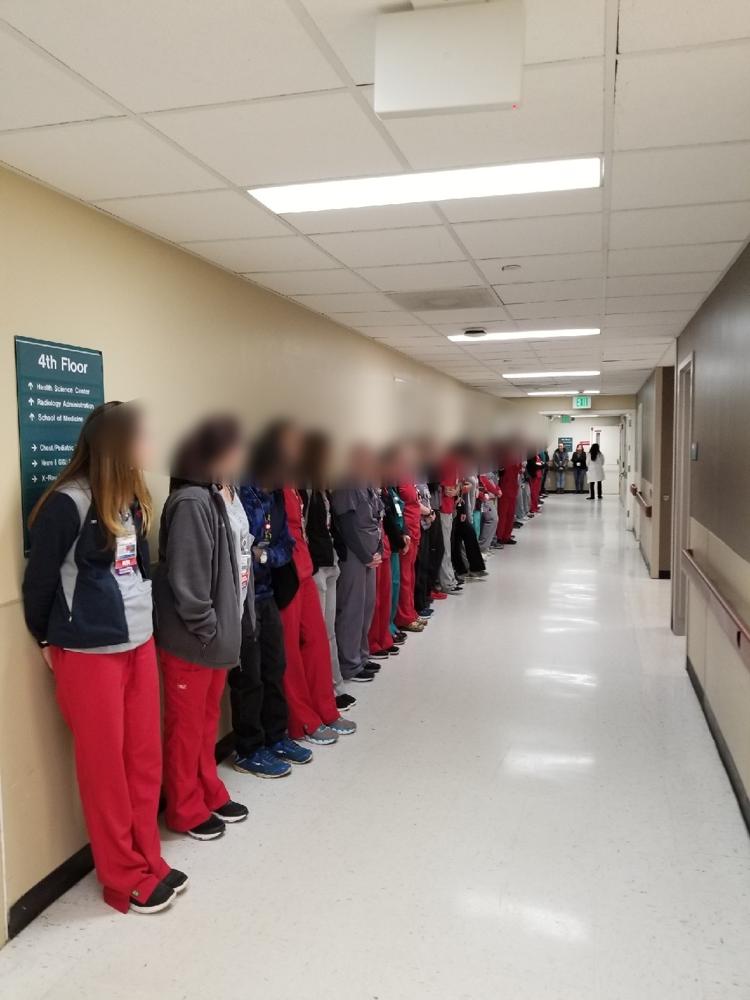
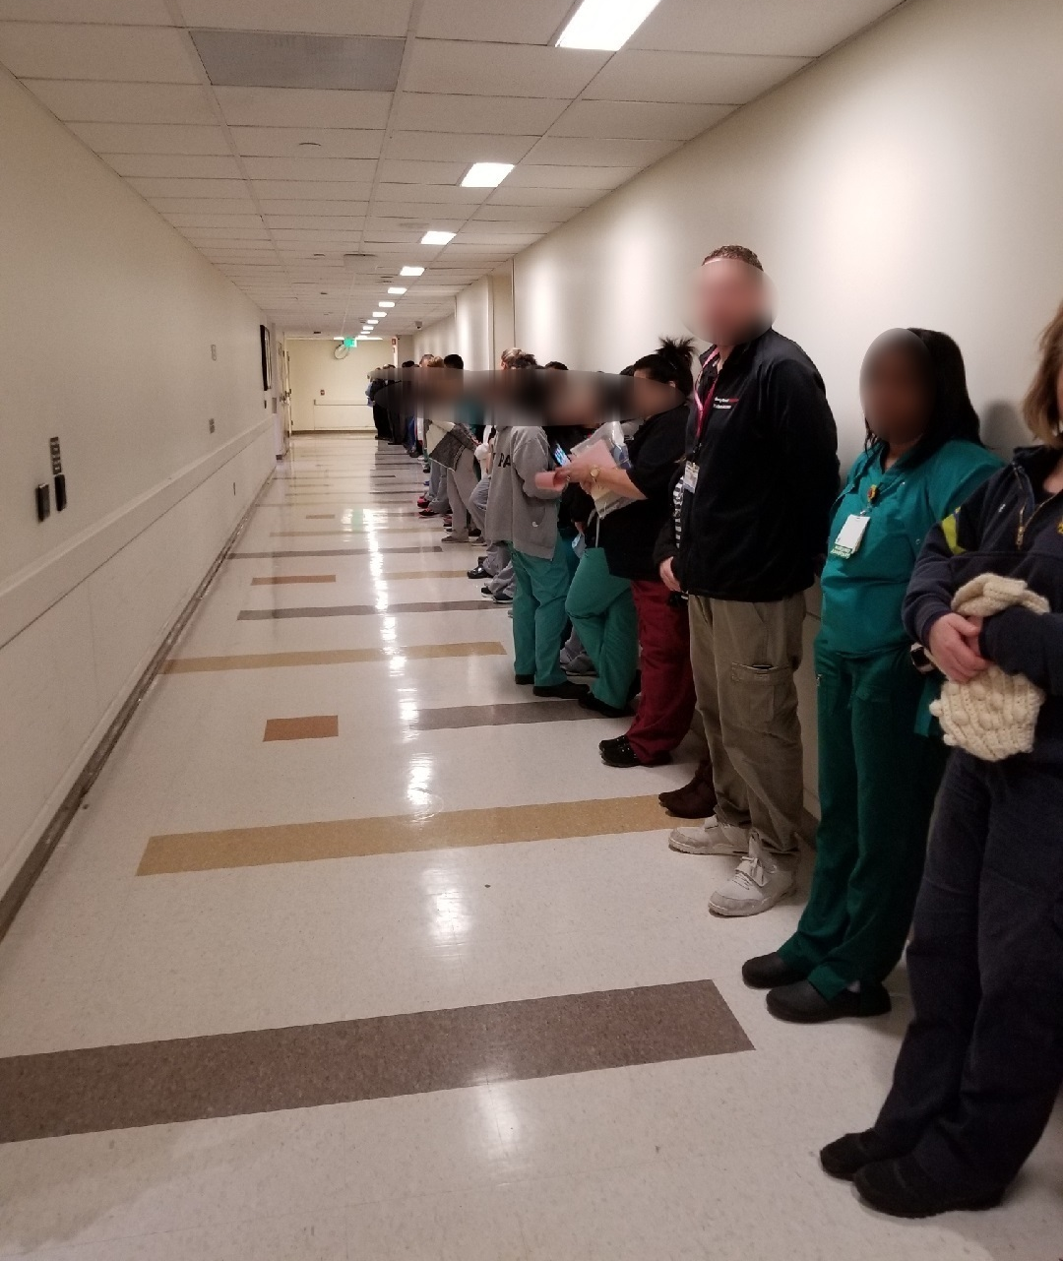
HONOR WALK

Slide 10
HONOR WALK
His gift:
Right kidney saved the life of a 18-year-young man
Left kidney saved a 51-year old woman
Liver segment 1 saved a 1-year-old baby boy
Liver segment 2 saved a 64-year-old man
Heart saved a 13-year-old teenage girl
Left lung saved a 75-year-old man

