Slide 1
National Liver Review Board
Ryutaro Hirose, MD
University of California, San Francisco
Region 5 collaborative

Slide 2
Purpose of NLRB – solving problems
The problems:
Inconsistent application and approval behaviors in the 11 UNOS regions – eliminate inconsistency (acceptance varied between 75-93% across regions)
Differences in practices
approval for HCC beyond criteria
E.g Approvals for ascites
Differences in rates of transplant for exception vs non exception rates by region (29->50% of transplant in exception patients)
MELD escalator resulting in ‘MELD inflation’ – eliminate the escalator
Awarding the same # of points for exception patients in the current environment of geographic inequity meant some exception patients get transplanted right away, others wait >1-2 years with ‘escalator’
Stable patients escalate above lab MELD patients who are sicker

Slide 3
NLRB
Three boards
HCC
Adult non HCC
Pediatric
Threshold for acceptance is a supermajority ( 4 of 5 reviewers must accept)
Different appeal process (appeal review team)

Slide 4
NLRB makeup
Review Board - NLRB - Adult HCC | Review Board Member | 110
Review Board - NLRB - Adult HCC | Review Board Alternate Rep | 109
Review Board - NLRB - Adult Other Diagnosis | Review Board Member | 110
Review Board - NLRB - Adult Other Diagnosis | Review Board Alternate Rep | 106
Review Board - NLRB - Pediatrics | Review Board Member | 55
Review Board - NLRB - Pediatrics | Review Board Alternate Rep | 56

Slide 5
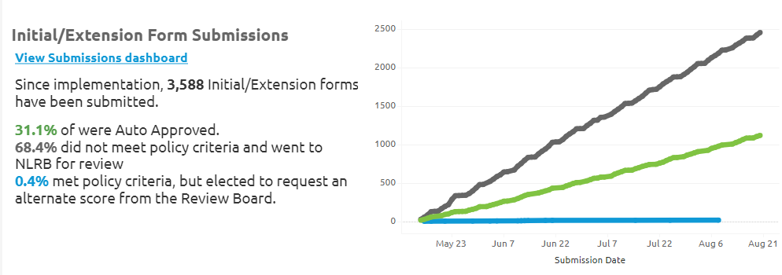

Slide 7
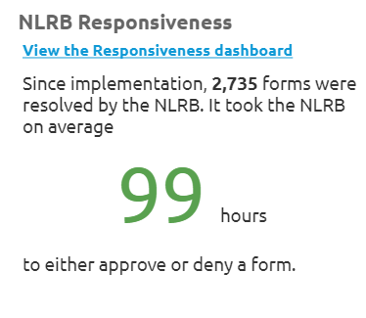

Slide 8
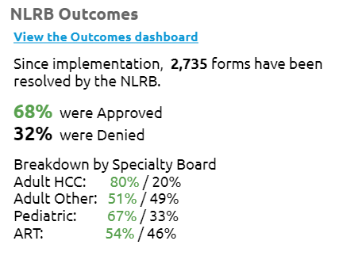

Slide 9
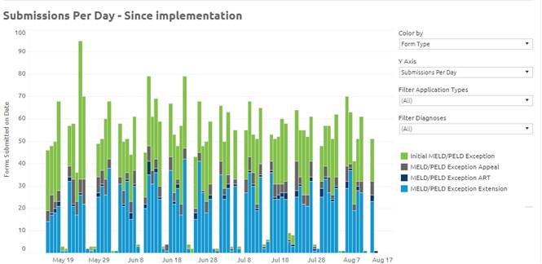

Slide 10
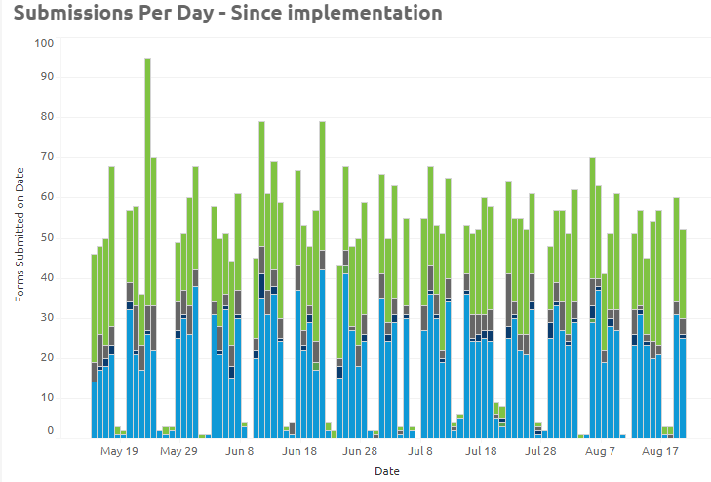
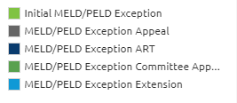

Slide 11
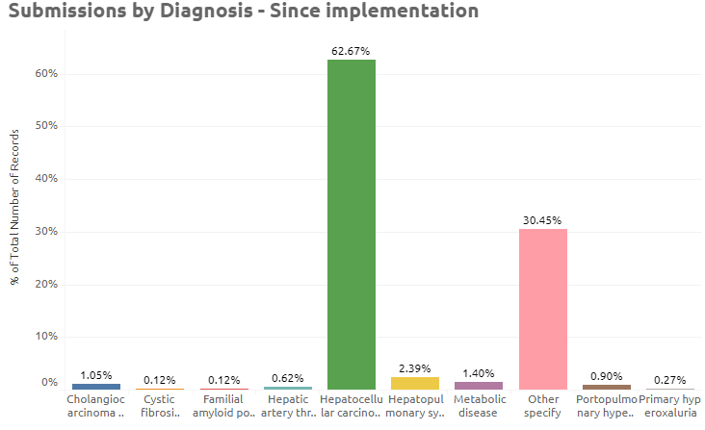
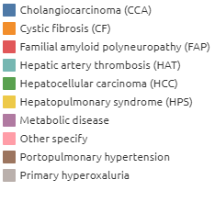

Slide 12
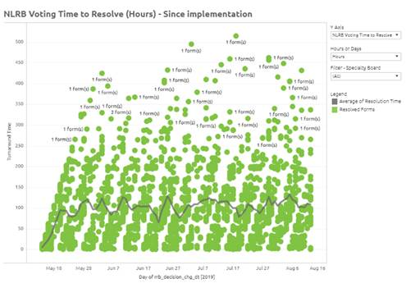

Slide 13
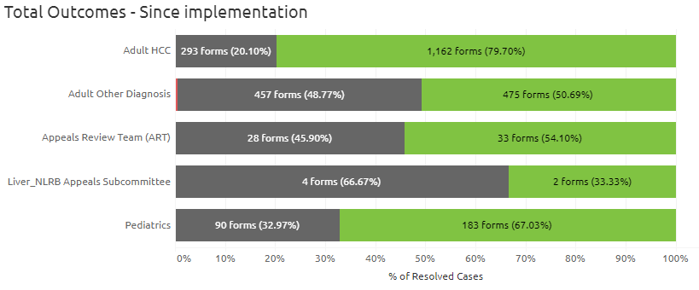
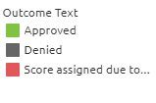

Slide 14
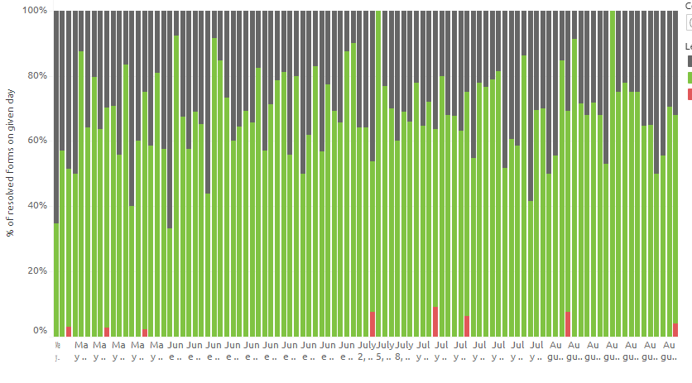

Slide 15
Growing pains of NLRB
Centers – inappropriate submissions for exceptions they may have gotten used to getting accepted under the RRB
Reviewers – inappropriate declines for submissions clearly within policy or guidelines
Editorial comments
Denials not based in policy
Liver transplant programs
Review the denials
RN coordinators should document
MD (content expert/HCC board member) should review criterion and see if denial is consistent with policy
Collate and document the rational for decline and to justify the approval to document a wrong decision by the NLRB

Slide 16
Consequences/problems that still exist and need to be addressed
HCC and other exceptions all stacked up at MMAT-3
Worse for patients in long wait regions
HCC patients not stratified
With each other
With respect to lab MELD patients

Slide 17
UNOS liver committee plans
Review of the decisions made by individual reviewers
Focused and general educational interventions
Julie Heimbach, MD – past chair UNOS liver committee, chair of UNOS NLRB
Elizbeth Miller, JD – UNOS policy analyst for UNOS liver committee

Slide 18
Questions and discussion

