Slide 1
OneLegacy Best Practices – Islet Cell Allocation
Keri Ichikawa
Donor Allocation Coordinator
OneLegacy

Slide 2
OneLegacy Pancreas Recovery and Utilization 2012-2019
PI = 1
PI = 0
PI = 1
PI = 2
PI = 3
PI = 0
PI = 1
PI = 0
Total PI = 7
Total Donors: 391 422 418 460 482 487 515 540

Slide 3
Local/Regional/National Transplant Distribution Rates 2012-2019
Total PI = 7
All Local Transplants
Notes:
81% goal set by DAC department based on modest increase from 2016 Year end 80% local utilization

Slide 4
Pancreas/Kidney-Pancreas Allocation Sequences A - B
Sequence A
Age ≤ 50 and;
BMI ≤ 30
PI Priority - Low
Sequence B
Age > 50 or;
BMI > 30
PI Priority - High

Slide 5
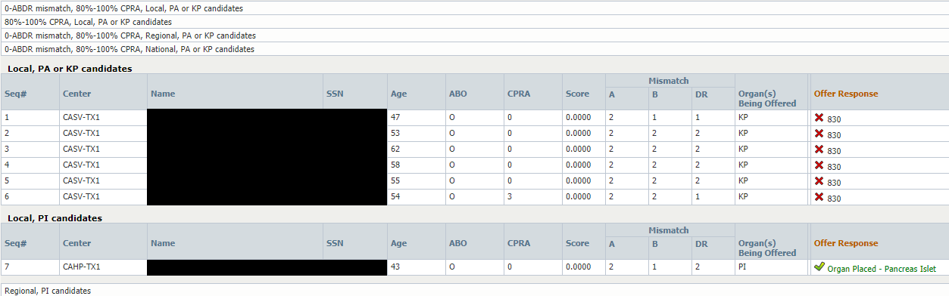
Sequence B – The easy way

Slide 6
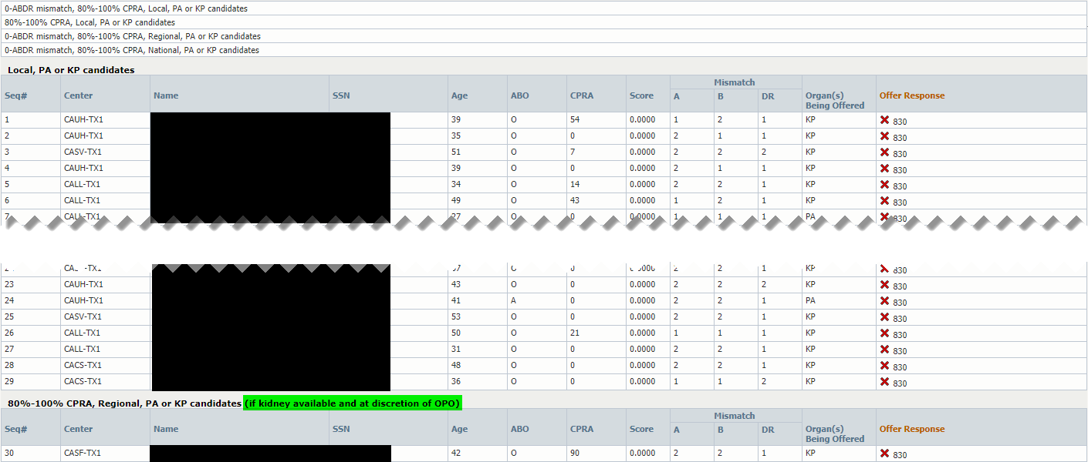
Sequence A – The hard way

Slide 7
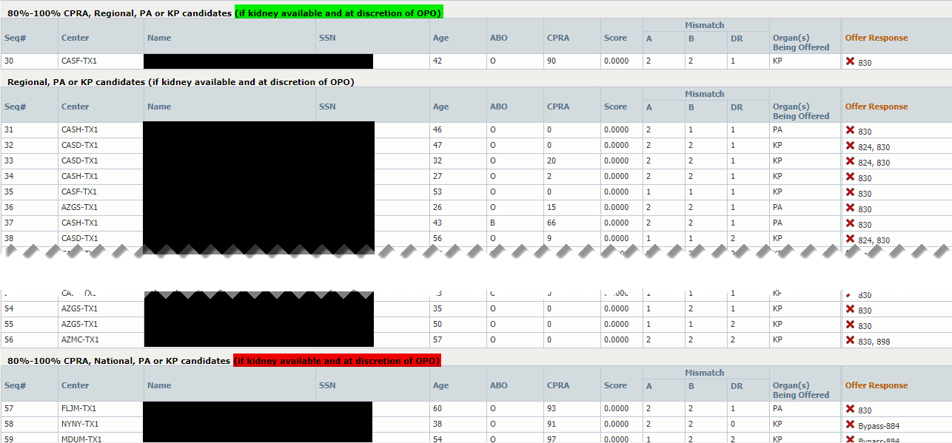
Sequence A – The hard way

Slide 8
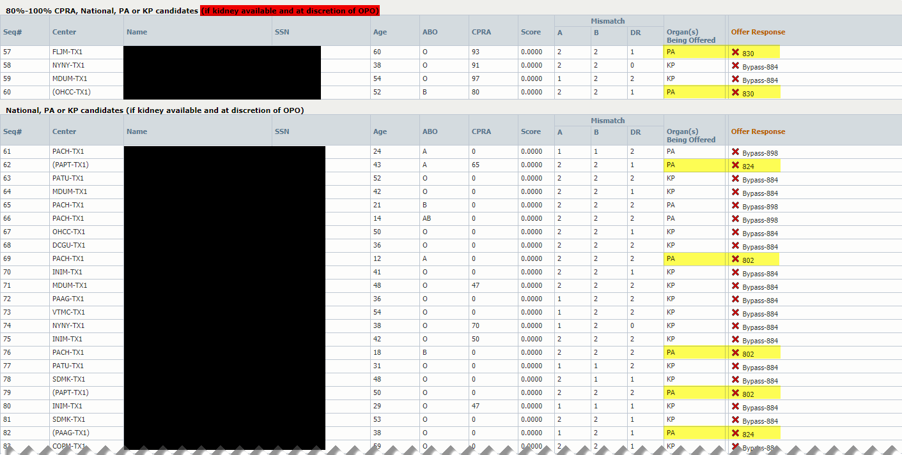
Sequence A – The hard way

Slide 9
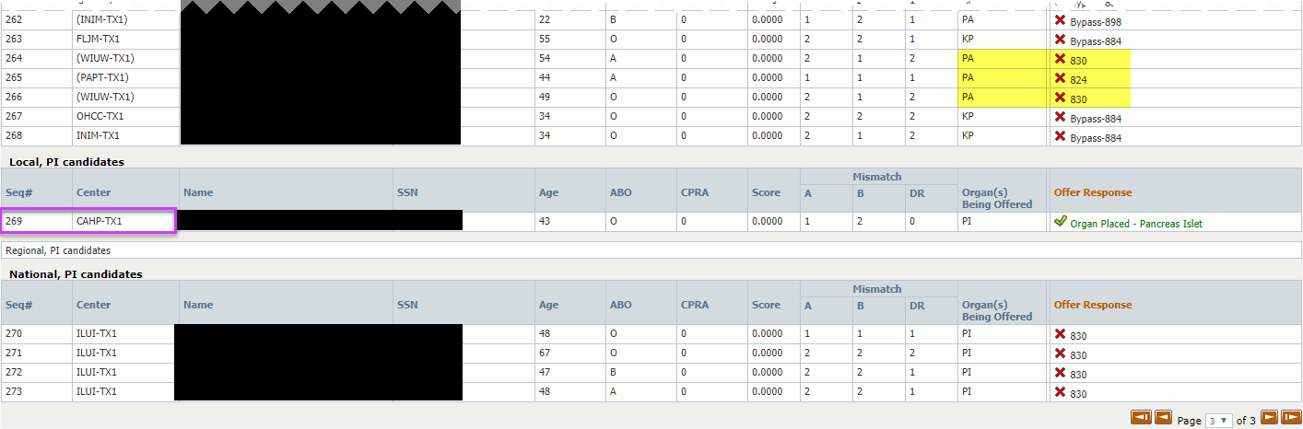
Sequence A – The hard way

Slide 10
Challenges Summary
Scan
Notify
Decide
Review match to identify any PI candidates
UNOS ID / Match ID to PI – Coordinator for early review
Interest in PI, helps OPO make decisions on allocation timing and back up status

