Slide 1
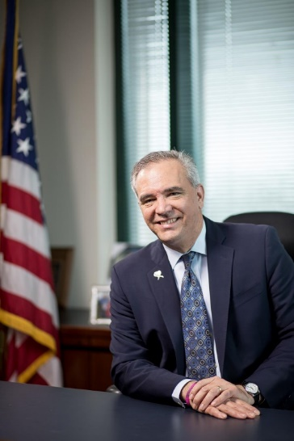
“Choosing to Lead”
March 19, 2019
Dennis Wagner, MPA
Director
Quality Improvement & Innovation Group
Centers for Medicare and Medicaid Services
U.S. Department of Health & Human Services

Slide 2
Thank You
For your hard work & commitment to the patients and families we serve
For your leadership and contributions to organ donation and transplantation
For the strategic thinking & active teaming of everyone in the room
For being part of the continued evolution and innovation of organ donation and transplantation

Slide 3
What We’ll Talk About Today
Leadership as a Self-Accountability
Using Bold Aims to Generate and Evolve Systems & Results
Cultivating a Powerful Shared Mindset through Leadership Speech Acts

Slide 4







CMS-Supported Quality Improvement and Innovation Work
Hospital Improvement Innovation Networks
4,042 Hospitals
Transforming Clinical Practice Initiative Model Test
140,000+ Clinicians in Practices
End Stage Renal Disease Networks
7,000+ Dialysis Facilities
Beneficiary and Family Centered Care (BFCC) Quality Improvement Organizations
~800,000 Reviews Performed
Quality Innovation Networks – Quality Improvement Organizations
~350,000 Clinicians
400 Communities
12,000+ Nursing Homes
3,800 Home Health Organizations
300 Hospice
1,700 Pharmacies
Help for Small, Underserved, Rural Clinicians to Participate in the MACRA Quality Payment Program
Up to 200,000 Clinicians

Slide 5
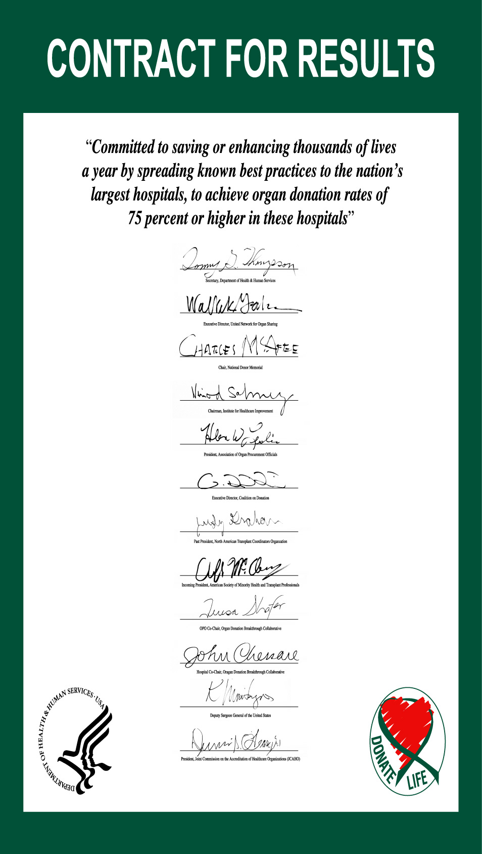

Slide 6
Increasing Organ Donation in USA
Jan 1999 – Apr 2007 (Monthly)
Organ Donation Breakthrough Collaborative
3 Years of Results
Collaborative Start Date

Slide 7
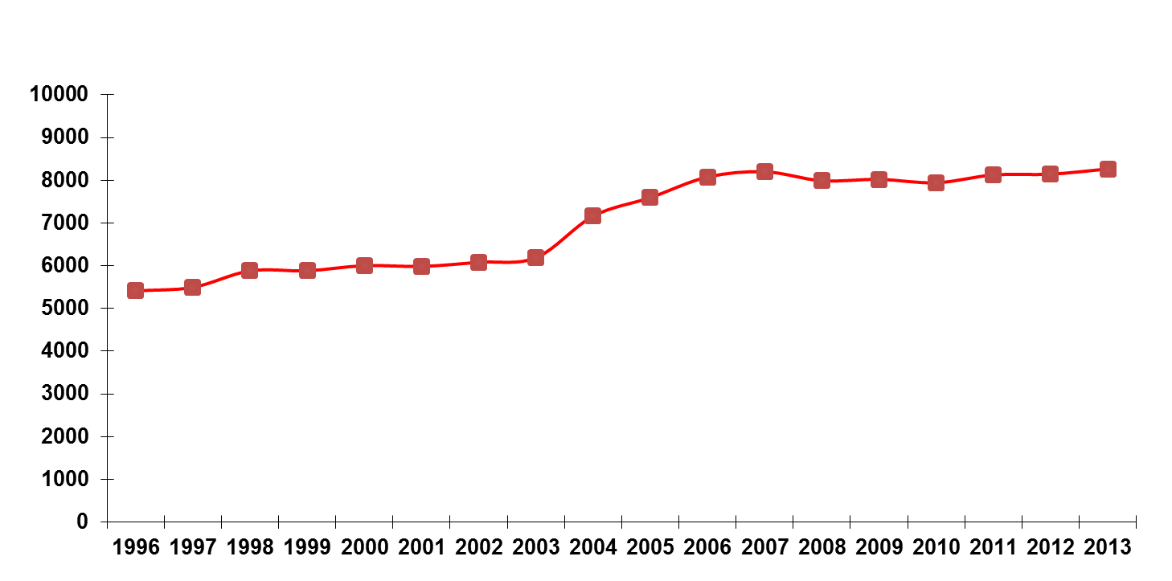
Major National Increases in Number
Of Organ Donors Per Year: 2003 to 2007
Notes:
Chart will be updated before Wednesday with data through 2013

Slide 8
A Key Mindset:
Leadership is a Self-Accountability
You can not delegate leadership or make some one a leader.
Leadership is a choice a person makes.
People choose to lead from many different jobs and roles
Leaders align with emerging leadership voices to move on strategic efforts.

Slide 9
A Powerful Model
Stimulus
Response

Slide 10
Choice: The Most Powerful Model
Stimulus
Response
CHOICE

Slide 11
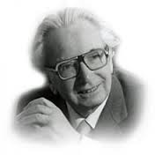
Viktor E. Frankl
Made Extraordinary Choices
Seminal Book: Man’s Search for Meaning
Notes:
We stumbled on in the darkness, over big stones and through large puddles, along the one road leading from the camp. The accompanying guards kept shouting at us and driving us with the butts of their rifles. Anyone with very sore feet supported himself on his neighbor's arm. Hardly a word was spoken; the icy wind did not encourage talk. Hiding his mouth behind his upturned collar, the man marching next to me whispered suddenly: "If our wives could see us now! I do hope they are better off in their camps and don't know what is happening to us."
That brought thoughts of my own wife to mind. And as we stumbled on for miles, slipping on icy spots, supporting each other time and again, dragging one another up and onward, nothing was said, but we both knew: each of us was thinking of his wife. Occasionally I looked at the sky, where the stars were fading and the pink light of the morning was beginning to spread behind a dark bank of clouds. But my mind clung to my wife's image, imagining it with an uncanny acuteness. I heard her answering me, saw her smile, her frank and encouraging look. Real or not, her look was then more luminous than the sun which was beginning to rise.
A thought transfixed me: for the first time in my life I saw the truth as it is set into song by so many poets, proclaimed as the final wisdom by so many thinkers. The truth -- that love is the ultimate and the highest goal to which man can aspire. Then I grasped the meaning of the greatest secret that human poetry and human thought and belief have to impart: The salvation of man is through love and in love. I understood how a man who has nothing left in this world still may know bliss, be it only for a brief moment, in the contemplation of his beloved. In a position of utter desolation, when man cannot express himself in positive action, when his only achievement may consist in enduring his sufferings in the right way—an honorable way—in such a position man can, through loving contemplation of the image he carries of his beloved, achieve fulfillment. For the first time in my life I was able to understand the meaning of the words, "The angels are lost in perpetual contemplation of an infinite glory...." ^{[7]}

Slide 12
Our Choices Matter Immensely
Stimulus
Response
CHOICE
We Can Achieve Our Aims by first Choosing to Make Them Happen

Slide 13
Questions for Reflection & Action
What are some of the most important leadership choices you have made in your career and in your life?
What are some of the leadership choices you are contemplating or are making at this particular juncture in your career and your life?

Slide 14
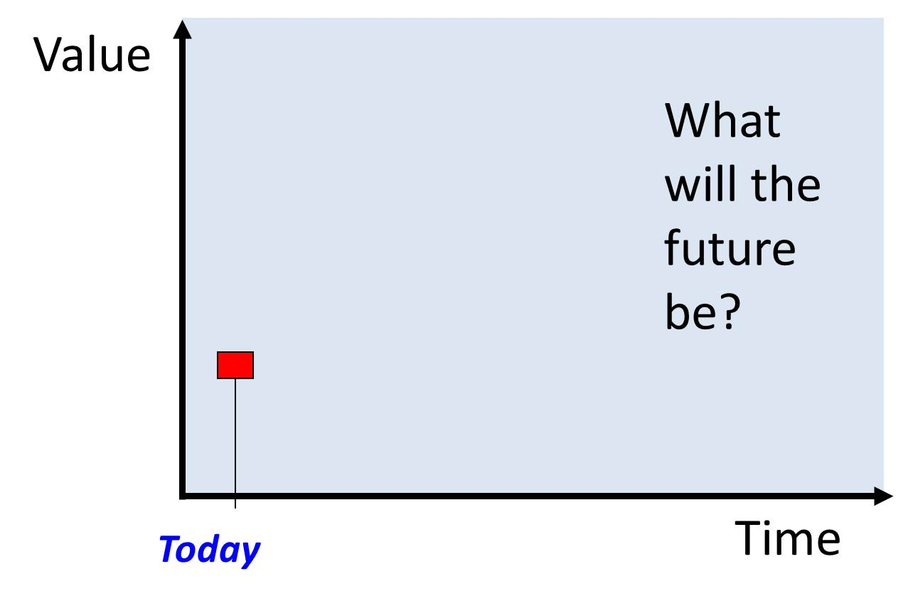
Aims & Results: a choice we make every day

Slide 15
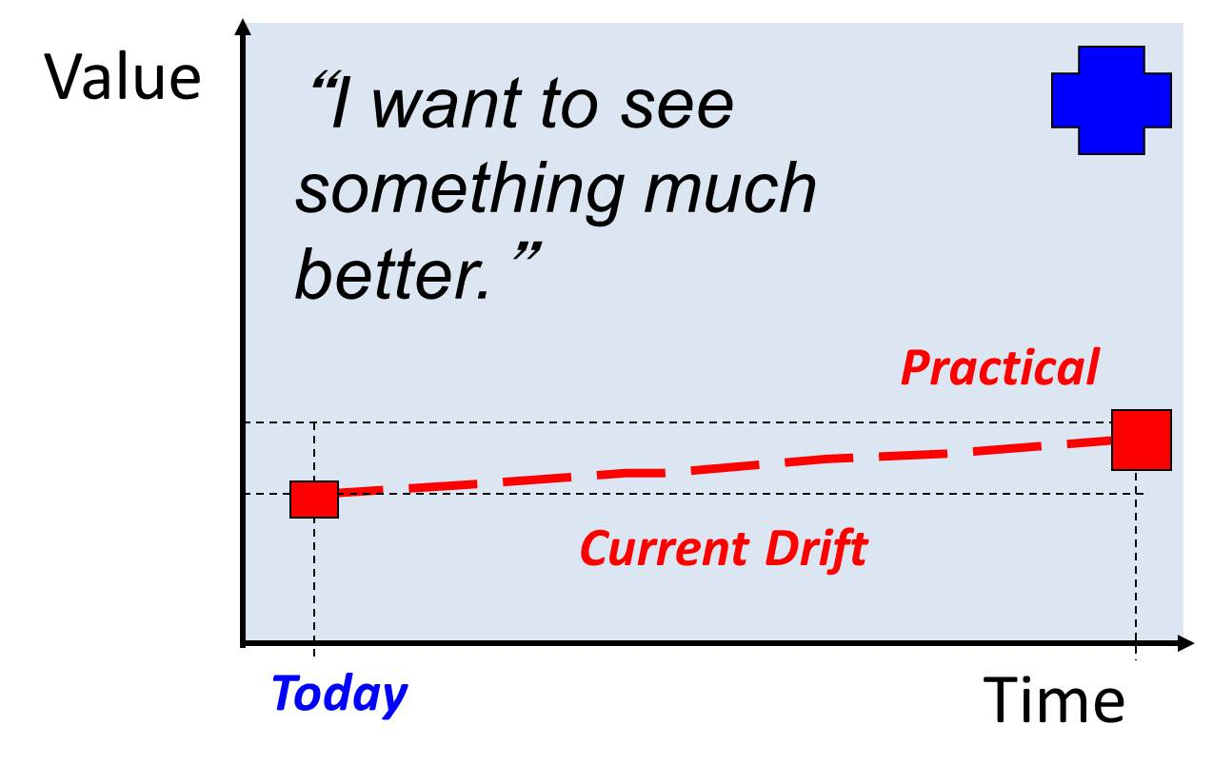
A Leadership Choice – Breakthrough Aims

Slide 16
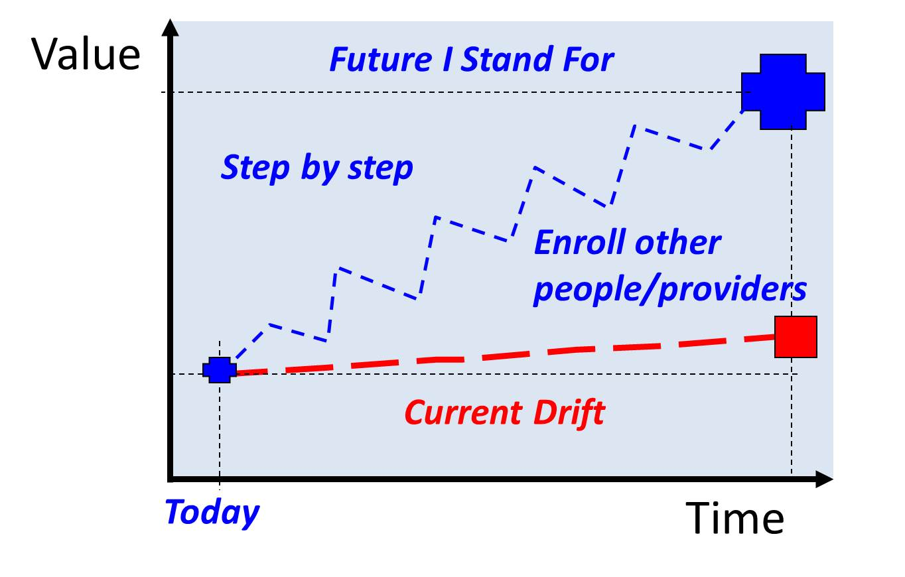
Emergent Strategy: Stand For Bold Aims, Enroll Others, Persist, Learn, Evolve...Fast

Slide 17
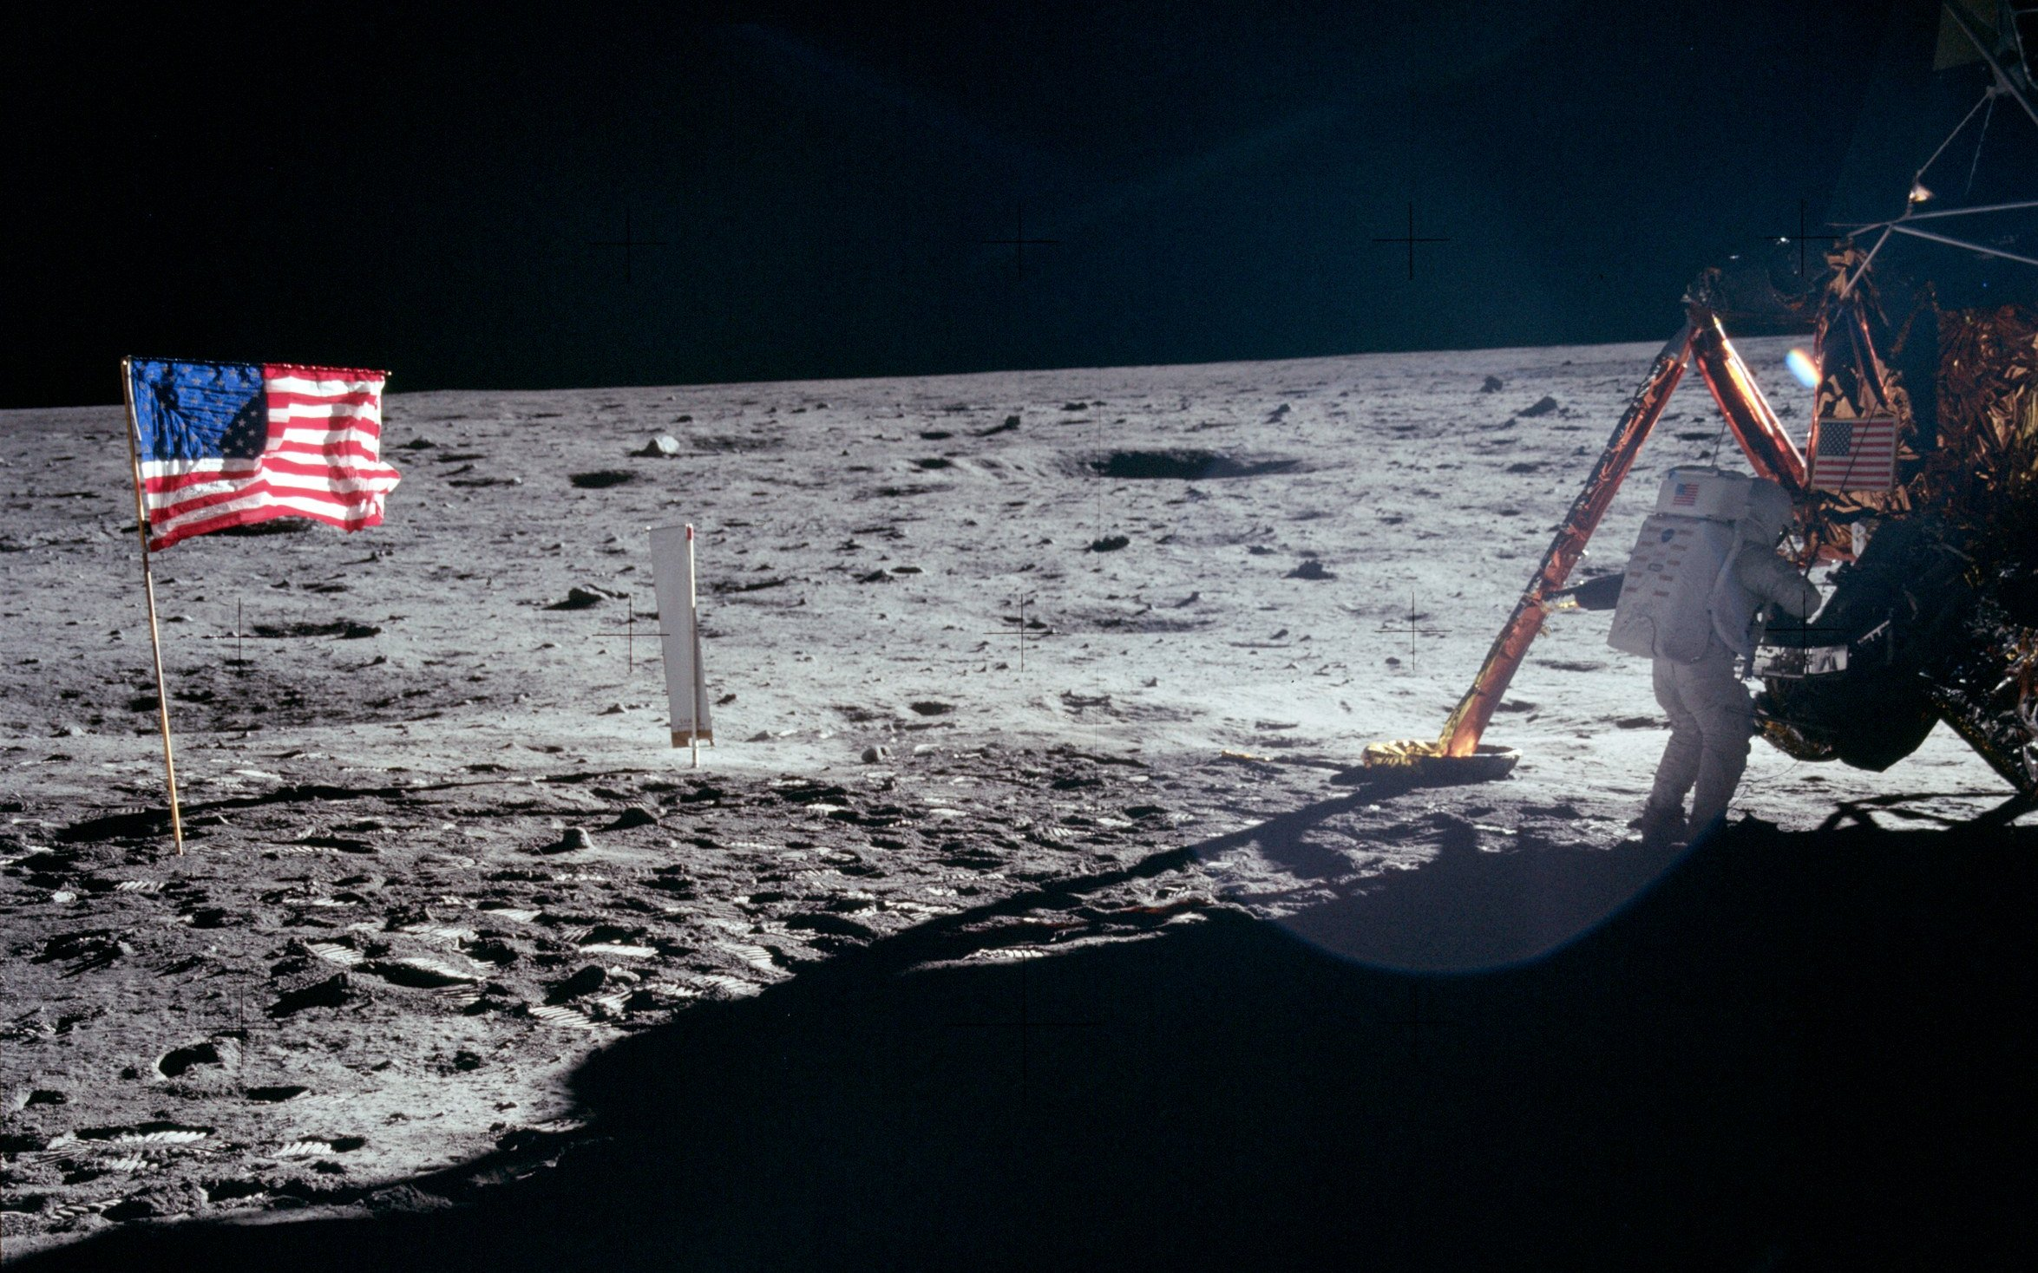
Bold Aims Create Systems; Systems Create Results
“I believe that this nation should commit itself to achieving the goal, before this decade is out, of landing a man on the moon and returning him safely to the earth.”
--- President John F. Kennedy,
Delivered in person before a joint session of Congress May 25, 1961
17
Notes:
17

Slide 18
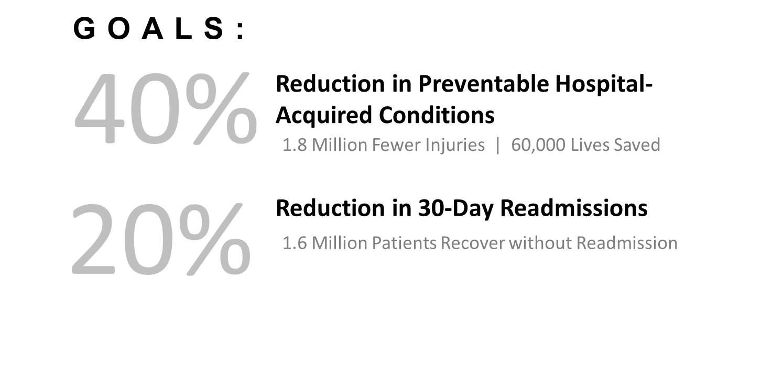
Partnership for Patients Model Test Committed to Two Breakthrough Aims in 2011
Aims Create Systems---Systems Generate Results
Source: Partnership for Patients

Slide 19
A Bold Aim and Hard Work by Many Thousands of Clinicians Led to Major National Results
2010-2014
39% Reduction in Preventable Harm
87,000 lives saved
$19.8B in cost savings
2.1M fewer harms
Source: Agency for Healthcare Research & Quality. “Saving Lives and Saving Money: Hospital-Acquired Conditions Update. Interim Data From National Efforts To Make Care Safer, 2010-2014.” December 1, 2015.

Slide 20
Partnership for Patients Established 2 New Breakthrough Aims for 2015 through 2019
Reduction in All Patient Harm
20%
12%
Reduction in 30-Day Readmissions

Slide 21
National Patient Safety Results
2014 through 2017
910,000 fewer harms
20,500 lives saved
$7.7B in cost savings

Slide 22
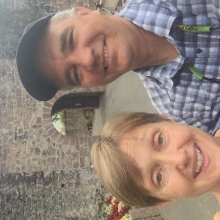
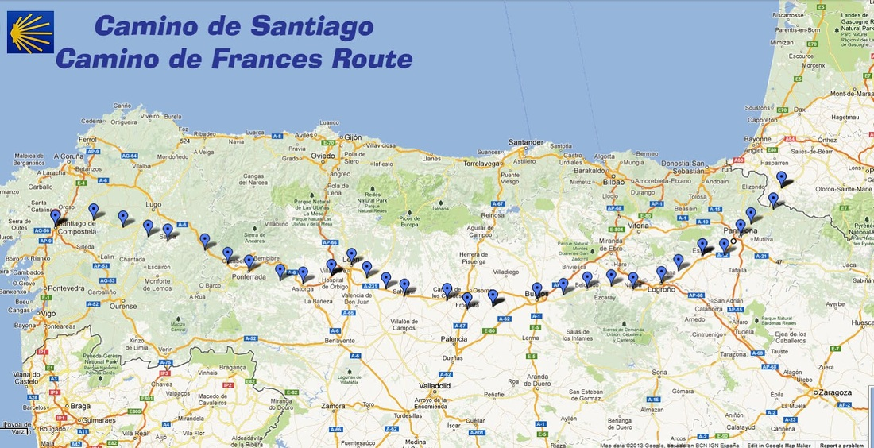

A Clear Purpose: Get to Santiago de Compostela
Santiago de Compostela!
St Jean Pied de Port in France to Santiago de Compostela in Spain:
799 kilometers -- 496.5 miles

Slide 23
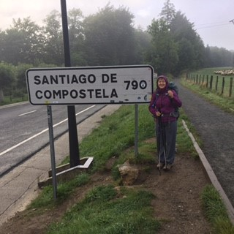
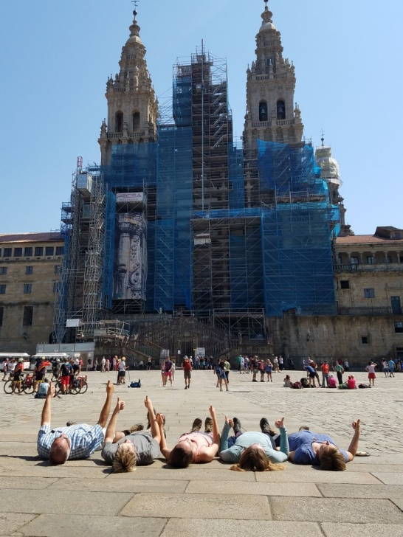
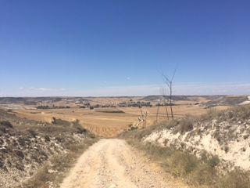
Plan, Do, Study Act in Action on the Camino!
My family discovered and implemented many opportunities for PDSA cycles!
Blister Prevention
Blister Treatment
Hydration
Backpack Adjusting
Managing & Minimizing Foot Pain
Spouse Collaboration

Slide 24
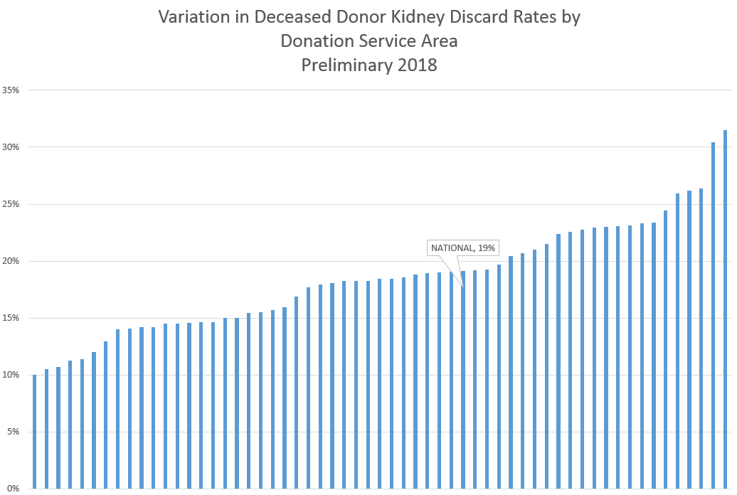

Slide 25
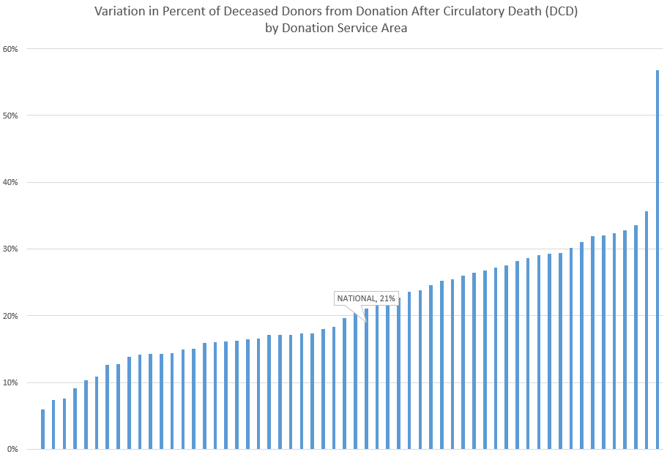

Slide 26
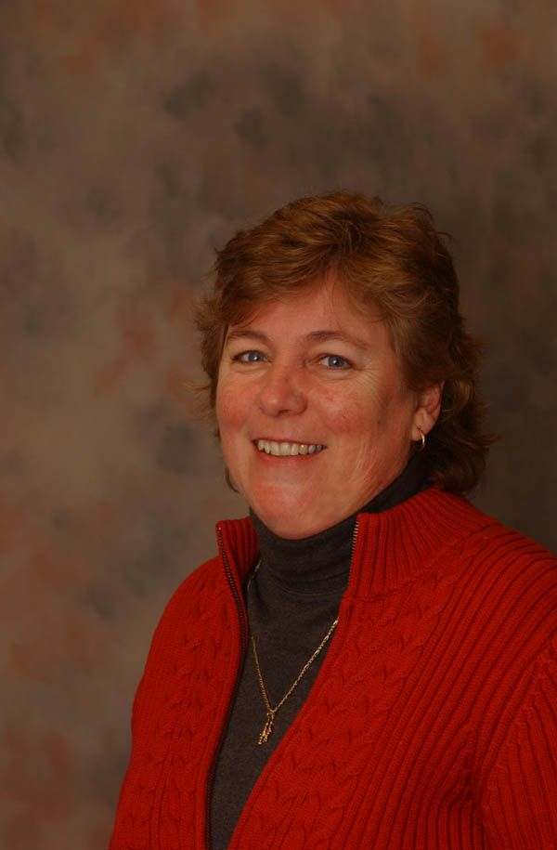

Slide 27
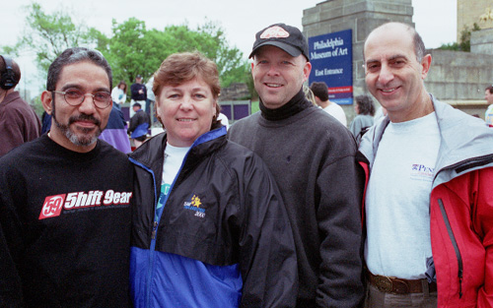
Recipient, Donor Mom, Procurement Leader, Transplant Surgeon
Photo taken in April 2002
Notes:
Susan M.
Donor Mother
John Edwards,CPTC
GLDP Transplant Coordinator
Dr. Avi Shaked
Recovery and Txp. Surgeon
University of Pennsylvania
Santos F.
Liver Recipient

Slide 28
Donation After Circulatory Death
Susan McVeigh Dillon Speaks to Collaborative Learning Session 2 in January, 2004…and Hospitals Throughout the Nation
47% Increase in DCD in 2004
More Big Increases in 2005
Today 21% of Deceased Donors Nationally are from DCD

Slide 29
Pause for Reflection
What are your experiences with using Bold Aims to build systems & drive results?
What bold aims are you committing to now… in your work and in your life?

Slide 30
A Powerful Shared Mindset: Leadership Speech Acts
Assertions
Declarations
Requests & Offers
Acknowledgements
“Yes, and”
Effective Questions
Leadership Happens Through Language

Slide 31
Leadership Speech Acts Are Not:
Complaints
Gossip
Worries & Frets
Ineffective Questions
Excuses
Blame
Leadership Happens Through Language

Slide 32
Questions for Reflection and Action
What are your reactions and insights about Leadership Speech Acts?
How might you use one or more of these Leadership methods (Choice, Aims to Create Systems, Leadership Speech Acts) to drive progress and results on organ donation and transplantation in your work?

Slide 33
My Requests to Each of You
Choose to Make & Stand for Bold Aims on Important Priorities like Reducing Kidney Discards and Increasing DCD
Intentionally Use Leadership Speech Acts to Drive Progress, Results and Teamwork
Use Your Individual and Organizational Platforms to Make This Happen
Share these Concepts of Choice, Using Aims to Create Systems & Results, and Leadership Speech Acts -- in the Next 24 Hours
Together, we can achieve our bold Aims.

