Slide 1
UNOS Update
Brian Shepard
CEO, UNOS
Region 2 Meeting
February 1, 2019

Slide 2
Vision: Long, healthy, and productive lives for persons with organ failure.
Mission: To advance organ availability and transplantation by uniting and supporting our communities for the benefit of patients through education, technology, and policy development.
Core Values:
Stewardship
Unity
Trust
Excellence
Accountability
Notes:
Like to start all presentations with the mission, vision and values of UNOS. These were approved as part of the 2018 – 2019 Strategic Plan last June.

Slide 3
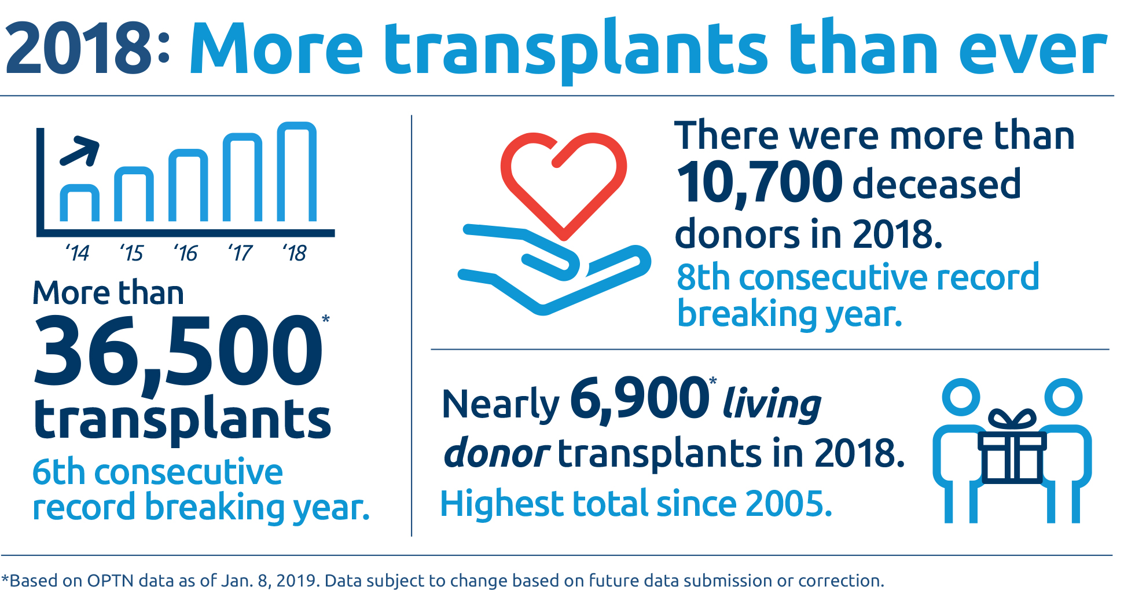
Notes:
I want to recognize the success of saving more lives this year than in the entire history of transplantation. In 2018, there were record numbers of deceased organ donors, living donors and organ transplants. Thank you for your work in making such a difference in people’s lives.

Slide 4
Geography

Slide 5
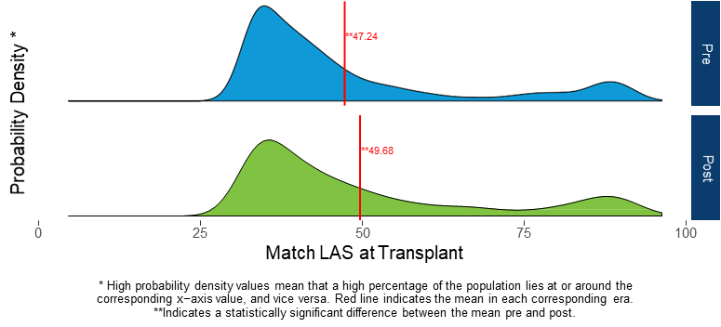
Monitoring the Lung Geography Change
Notes:
Background:
This figure shows the distribution of match LAS at transplant
Findings:
The average match LAS at time of transplant for the pre era is 47.24 and 49.68 for the post era.
There is a statistically significant difference between the mean LAS in the pre era compared to the post era
The OPTN Thoracic Committee discussed whether this was a clinically meaningful increase. Committee members commented than over a 2 point increase did represent a clinically sicker population receiving transplants.
Additionally, there were 249 recipients with a LAS of at least 75 in the pre era and 294 in the post era.

Slide 6
Other lung metrics 9 months after
Reduction in deaths in LAS 60-70
Increased median travel (116 nm to 166 nm)
Increased overall ischemic time (5h18 to 5h33)
Increase in the number of lung transplants
https://optn.transplant.hrsa.gov/governance/public-comment/modifications-to-the-distribution-of-deceased-donor-lungs/
Notes:
Recall this went into effect November 24, 2017.
Draw attention to Increase in mean match LAS at transplant: 47.24 to 49.68
Increase in median distance: 116 to 166 NM
Thoracic Committee watching the increase in overall ischemic time. Includes cold time, warm time and anastomosis time

Slide 7
Revisions to liver distribution
December 2017: Liver Distribution Policy passed by the Board
June 2018: Critical Comment letter to HHS
June 25, 2018: Executive Committee charged Liver Committee
Remove DSA & region from liver allocation by December 2018
Amend liver allocation policy to be compliant with the Final Rule
July 2018: Lawsuit filed on behalf of six patients in CA, NY, MA
July 2018: Directed by HRSA to remove DSA from geography policies

Slide 8
Special Public Comment: Oct 8-Nov 1, 2018
Two new liver distribution models developed by Liver Committee
Acuity Circles model (AC)
Broader 2 Circle model (B2C)
Record 1,246 comments (second highest – 647 comments in 2017)
6 committee presentations/2 national webinars/11 regional webinars
21 Liver/Intestine Committee meetings
Final Committee recommendation of B2C by 11 - 9 vote

Slide 9
Board Meeting Summary
Several Board pre-meeting calls to review the proposed policy
Several amendments submitted prior to Board meeting
Liver/Intestine Committee Report with recommendation of B2C Model
Amendments arranged in order, with visual aide for Board members to follow
Board heard pros and cons of both models (B2C and AC), with input from every Board member.
Final vote for Acuity Model 30-7-2. Total discussion time: 3 hours 45 minutes.
This decision received approval in a subsequent letter from the Administrator of HRSA on 12/19/18.
Notes:
After a robust Board-level discussion in which presentations in favor of the Broader 2 Circle and Acuity Circles models were presented and debated, the OPTN Board voted on December 3, 2018, to adopt the Acuity Circles policy by a final vote of 30 in favor, 7 against, and 2 abstentions.
Overall, demographic subgroups (age, sex, and race/ethnicity) were similar between the modeled scenarios and the total population.
Exception: Pediatric subgroup saw reductions in MMaT and increases in transplant rate compared to the overall population
Trends for the socio-economic status characteristics (education, insurance type, cumulative community risk score, and urbanicity) were similar between the modeled scenarios and the total population.

Slide 10
Next Steps for Implementing New Liver Policy
National Liver Review Board (NLRB) implementation delayed to ~ April 1
- current PC proposal to address transition scores
NLRB education available through Transplant Pro
Distribution Policy modules for centers/OPOs available in March
Live electronic Q&A meeting in April
Acuity circle distribution policy takes effect April 30

Slide 11
Geography next steps
Organizational commitment to ensure all future changes to geographic allocation are in alignment with the final rule
Board approved Continuous Distribution Model (Vote 36-1)
Heart, VCA have current PC proposals
Kidney/Pancreas concept paper
Geography Committee’s work is completed/committee disbanded

Slide 12
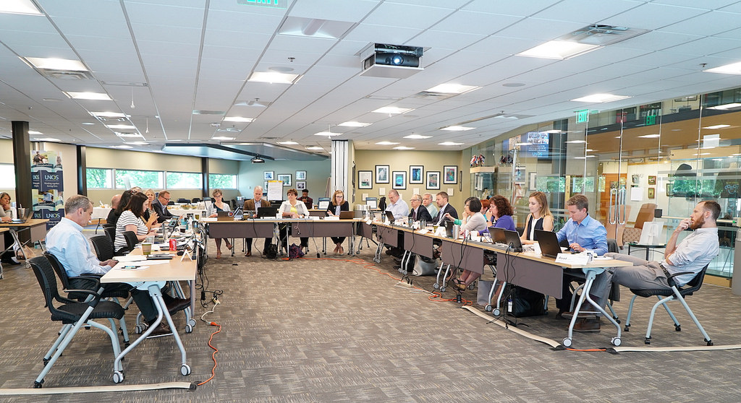
OPTN/UNOS Ad Hoc Committee on Systems Performance
August 2018-March 2019
Notes:
Created by Dr. Yolanda Becker during her term

Slide 13
Membership
Ad Hoc Systems Performance Committee
Matt Cooper
Diane Brockmeier
Systems Dynamics Work Group
Jeff Orlowski, Stuart Sweet
OPO Work Group
Susan Gunderson
Tom Pearson
Transplant Program Work Group
Lisa Stocks, Dave Foley
60 members
Co-chaired by OPO and Transplant MD pairs
32 Transplant program professionals (MD & non-MD)
20 OPO professionals
3 Patient & Donor Affairs
HRSA & SRTR
Notes:
Thank Matt and Diane for their leadership on the committee, the co-chairs of the work groups that each include an MD and OPO leader, and those of you who are members of one of these groups.

Slide 14
March 11-12, 2019 Meeting Chicago, IL
Open to the public
Goals
Synthesize Work Group recommendations
Gather feedback on Committee recommendations
Report to Board (June)
https://optn.transplant.hrsa.gov/members/committees/ad-hoc-systems-performance-committee/
Notes:
Registration link can be found on the OPTN website under Committees>>Ad Hoc Systems Performance Committee
Meeting is at the Rosemont Hilton

Slide 15
March 11-12 Systems meeting topics
Tools and Technology
Dashboards (self-monitoring metrics)
Research and IT tools
Predictive analytics
Efficient recovery and placement
Performance Monitoring
OPO and Transplant Center metrics
Collaborative Improvement
Future collaborative projects
Effective relationship building
Broader Horizons
Recommendations beyond the traditional scope of OPTN

Slide 16
OPTN member support
844-395-4428
member.questions@unos.org
Notes:
We’ve made some changes in the way we support our committees, our regional meetings, and answer your questions. If you’re serving on the board or a committee, you’ll get a detailed update of how this restructuring helps you in that role.
For most members, the most visible change is that you have a single number and/or email that

Slide 17
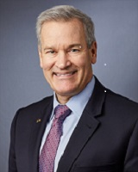
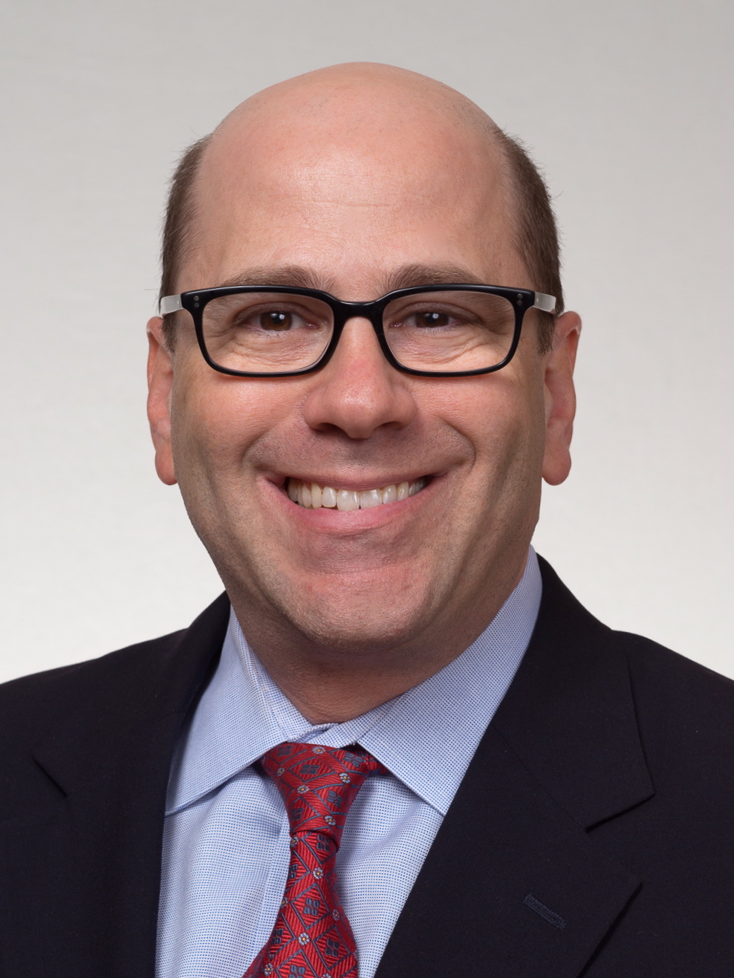
Board of Directors
election
February 6 –
February 28
Candidates for
Vice President/ President-Elect
David Mulligan, M.D
David Reich, M.D

Slide 18
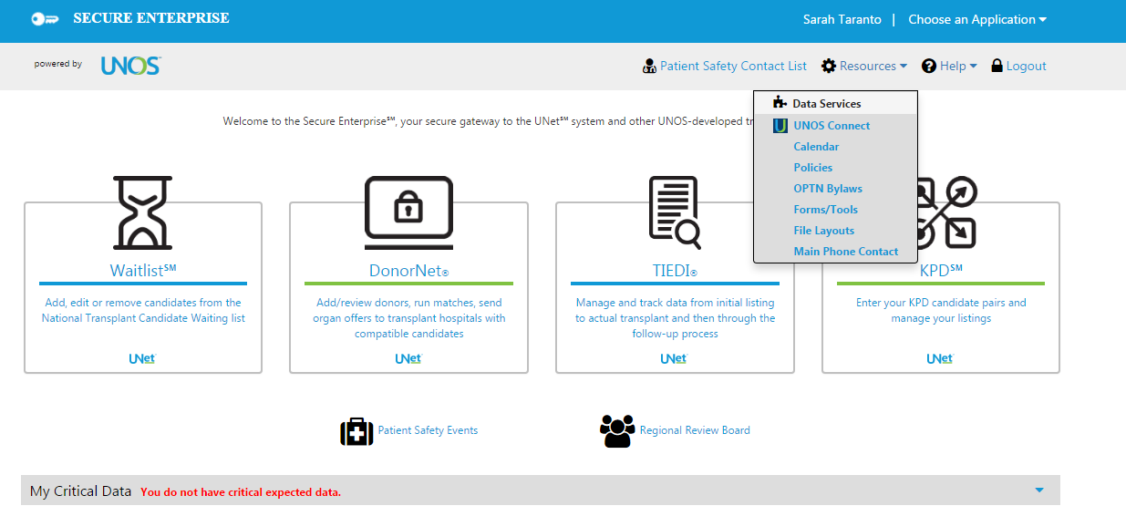
UNOS Data Services Portal
Benchmark Report
Kidney Waiting List Management Tool
Report of Organ Offers (ROO)
Recovery & Usage Maps (RUM)
Center STAR files
Data Quality & Submission Monitoring Tools
Commonly Requested Reports
dataportal.feedback@unos.org
Notes:
If you haven’t, please check out all the great data tools on the Data Services Portal. See the list here of standardized reports.

Slide 19
Improving transplantation
through research, innovation and collaboration
Notes:
UNOS Labs is doing some very innovative projects that are quite interesting

Slide 20
Behavioral Research
Simulation studies to test behavior
Acceptance practices
Data Science
Predictive analytics tools
Novel data processing techniques
Technology Innovations
Tools, dashboards, or calculators
Feasibility or optimization studies
Advanced data mining
Experimental platforms
System enhancements
Future of transplant: perfusion, xenotransplant, bioengineering, etc
Notes:
Three key areas: Behavioral Research, Data Science and Technology Innovations

Slide 21
Current UNOSLabs work
Offer simulations
Clinical decision aids - calculators
Electronic donor referrals
Image sharing in DonorNet
Natural language processing
Discard risk
Exception scores
Speech recognition
Projecting travel time

Slide 22
OPTN contract
HRSA options extend through September 30, 2023
Specific initiatives for
collaborative improvement
APIs/electronic interconnectivity
More focus on innovation incentives
More clarity for OPTN role vs other UNOS activities

Slide 23
OPTN/UNOS Update
Brian Shepard
CEO, UNOS
Region 2 Meeting
February 1, 2019

