Slide 1
Updates on the New Adult Heart Allocation System
Thoracic Organ Transplantation Committee
Notes:
Hi, my name is _____________________________ and I’ll be providing you all with an update on where we are with implementing the changes to the adult heart allocation policy that were approved in December 2016. After that, I’ll talk about the proposal to modify how we distribute deceased donor lungs.

Slide 2
Timeline
Programming anticipate to be complete Q3 2018
2-phase roll-out
Phase 1 (30 days): complete new status justification forms and enter risk stratification data for all active heart candidates
Phase 2: UNet will allocate hearts using new statuses
Notes:
UNOS has been working hard on programming the new adult heart allocation system. It is currently scheduled to go live some time in the third quarter of 2018. We will do a 2-phased roll out. During the first phase, which will be a 30 day period, you will update all the information you have for all your heart candidates in new status justification forms that align with the 6 new statuses. Those forms also contain a risk stratification data section, where you’ll submit data on each candidate that will ultimately help us build a heart allocation score in the future.
Phase 2 is the day the system will go live and use the new status justifications to allocate hearts.

Slide 3
Adult Heart Allocation
Available Now:
HRT102 - Adult Heart Allocation Policy Revisions
Coming in 2018:
Toolkit – February (Available on Transplant Pro)
Patient brochure- March (Available on Transplant Pro only)
Transition training – April
How to talk to patients and System training – May
Regional Review Board training – June
OPO training – July
All instructional offerings are available in:
Notes:
Because there is so much to learn about the new allocation system, we have been working with UNOS Instructional Innovations to develop several instructional offerings for this policy to assist members with the upcoming changes . All instructional offerings are available in UNOS Connect.
The Adult Heart Allocation Policy Revisions webinar recording was made available in November 2017. This webinar explains what to expect with expanded medical urgency statuses for adult heart allocation and reviews policy changes and the rationale behind them.
We have also posted a heart allocation toolkit on TransplantPro that contains additional resources for understanding the new policy changes.
Questions and Answers for Transplant Candidates about Adult Heart Allocation Policy Patient Brochure will be available in March in the UNOS online store. The brochure will provide an overview of the new allocation system and address common questions for transplant candidates or family members. We will also provide a Spanish-language version of the brochure.
Transition training will be available in April and will provide tips for approach to transition to adult heart allocation system.
How to talk to patients and System Training will be available in May and will provide information on how transplant professionals can explain the heart allocation system changes to their patients as well as an explanation of the Unet system changes.
The Regional Review Board training will be available in June and will explain what the regional review board members can expect as a result of the policy changes. It will serve as ongoing onboarding for new members.
And an OPO training will review how match runs may appear differently and will be available in July 2018.

Slide 4
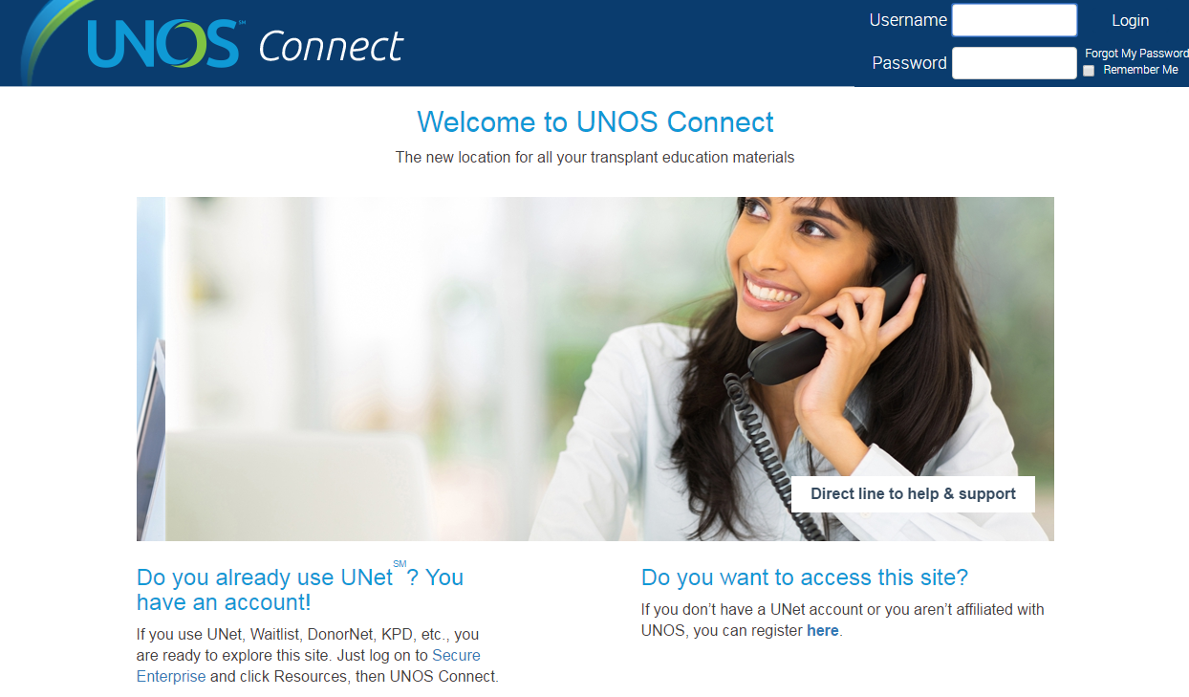
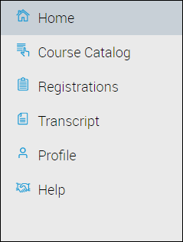
UNOS Connect
For assistance in locating, registering and starting courses, please review help documentation.
Visit UNOS Connect:
https://unosconnect.unos.org
Notes:
All Adult Heart Allocation offerings are available on UNOS Connect, UNOS’ learning management system (LMS). You can access UNOS Connect by going to UNOSConnect.unos.org as shown on this slide.

Slide 5
Questions?
Kevin Chan, MD
Committee Chair
kevichan@med.umich.edu
Liz Robbins Callahan, Esq.
Policy Manager
Liz.robbins@unos.org

