Slide 1
OPTN Strategic Planning Feedback Board of Directors
November 12, 2014
St. Louis, Missouri

Slide 2
OPTN and UNOS Strategic Planning
Updating 2012 Strategic plan
Now planning for 2015-2018
Regions
Board
Executive Committee/CAC
Regions
Board
Notes:
We’re updating the 2012 strategic plan. Because we’re the community’s organization, we started by going to the community, and have had this conversation in 5 regional meetings so far.
This afternoon, I want to get the Board’s input on the main goals of the strategic plan and some of the activities that UNOS should focus on in the next three years, before the Board leadership writes a draft plan in February.
We’ll let the community see and comment on that draft in the spring, and then bring the plan back to the Board for discussion and approval next June.

Slide 3
OPTN 2012 Strategic Goals
Increase the number of transplants
Increase access to transplants
Improve survival for patients post-transplant
Promote transplant patient safety
Promote living donor safety
Promote the efficient management of the OPTN
Notes:
The current OPTN plan has six strategic goals (see slide).
These first four have been in every plan for 30 years, and LD safety specifically broken out about for the first time about 10 years ago. Efficiency new to this plan.
FYI - UNOS goals are to be the OPTN contractor, to serve member needs, and to be a world leader. I think the discussion at the meetings will mostly be OPTN, and if there are activities we can’t do under contract, we’ll move them to UNOS. The UNOS/OPTN dividing line isn’t really important for the brainstorming sessions.
- Are these the right six? Any amendments, additions, deletions? (Then we’ll move on to prioritizing)

Slide 4
Projects by Strategic Goal
Notes:
To put the committee projects into perspective, I’ll show you a couple slides…
Projects by Strategic Plan
All projects must support the strategic plan. Several projects are initiatives taken directly from the strategic plan. Similar to project types below, many projects support more than one goal within the strategic plan. The following chart shows the number of projects that affect each strategic goal.

Slide 5
SWITCH TO VOTING SLIDES

Slide 6
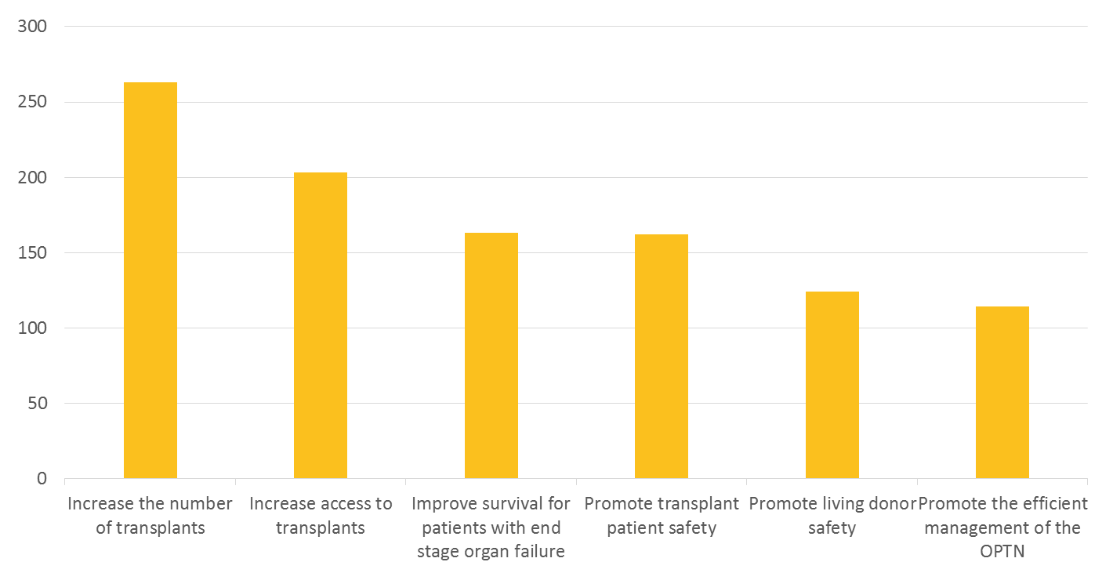
Feedback from Regional Surveys
49 Survey Responses
Notes:
Five regional feedback sessions have been held to date with approximately 130 people in attendance. Prior to the sessions, a survey was sent to registered participants. Participants were asked to rank the goals in order of importance to their practice to provide guidance to the Board as to how OPTN resources should be allocated. We received 49 survey responses.
The graph in this slide reflects a weighted ranking of the responses received.

Slide 7
Increase the Number of Transplants
Revise current performance measurements:
Account for candidate and donor characteristics
Establish distinct performance measures that account for marginal donors and candidates with existing co-morbidities
Minimize disincentives for transplanting marginal organs
Conflicting CMS and OPTN priorities for OPOs and Transplant Centers
Notes:
In summary, the regional conversations focused on three areas: decreasing disincentives to transplanting marginal organs, increasing the utilization of organs and removing barriers for living donation.
Revising the current performance measurements was discussed in several regions to account for specific candidate and donor characteristics. Members suggested that the OPTN establish distinct performance measures that account for marginal donors and candidates with existing co-morbidities. They also noted that the OPTN and CMS have conflicting priorities. CMS regulations push OPOs to recover every organ every time, and the transplant centers that use marginal organs are flagged by the OPTN for performance reviews.
Members recognized that an increase in the current donor pool is not likely and organ utilization can be optimized through the suggestions on the next slide.
Barriers to living donation need to be identified and assess how barriers and disincentives can be removed or minimized.

Slide 8
Increase the Number of Transplants
Increase Utilization of Organs
Better DCD utilization
Design a system to expedite offers of marginal organs to programs that will use them
Revise OTPD metrics to promote recovery of single organ donors
Increase split liver utilization
Identify and track donor management strategies that increase organ yield
Track surgical recovery error rate
Investigate the use of survival matching for all organs
Review discard rates and identify improvement measures
Promote the repair of organs (ex. ex vivo perfusion machines)

Slide 9
Increase the Number of Transplants
Minimize barriers and disincentives for living donors:
Create national standard for donor assistance
Decrease follow-up requirements for “standard living donors” and increase requirements for “high risk living donors”

Slide 10
Increase Access to Transplants
Develop objective listing criteria to ensure national consistency of potential transplant candidate pool
Decrease Geographic Variation
Understand an OPOs donor growth potential
Continue efforts to standardize transplant rates by decreasing geographic disparity

Slide 11
Promote Efficient Management of the OPTN
Increase agility of current policy development and implementation processes to match evolving clinical practice
Assess performance on current goals and activities
Focus on activities that will demonstrate measurable change
Collaborate with professional organizations and regulatory agencies to minimize duplication of effort
Notes:
In summary the regional conversations focused on the following:
policy development and implementation processes need to be nimble enough to respond to a dynamic clinical environment
assess the current allocation of resources for goals and activities
focus on projects that will have the broadest community impact and complete them in a timely manner
actively review the project list to identify potential areas of collaboration with professional or regulatory bodies to avoid duplication of effort

Slide 12
SWITCH TO BOARD RESULTS

Slide 13
POC Feedback

Slide 14
Next Steps
Summary of regional discussion submitted to the Board
Early 2015 - Board drafts proposed strategic plan
Spring 2015 - Regions review proposed plan
June 2015 - Board approves new strategic plan
Notes:
A summary of today’s discussion will be submitted to UNOS executive leadership as they develop a draft plan in early 2015. The draft plan will be available for review in the Spring before going to the Board of Directors in June for final approval.
As your councillor this feedback is helpful to me as I work with the Board to develop draft and final strategic plans.
I want to thank everyone for attending this session and for actively participating in the process.

Slide 15
Additional slides – info from current plan

Slide 16
Increase the Number of Transplants
Increase the number of organs transplanted from each donor
Measure outcomes and drive performance improvement in OPOs
Reduce unintended consequences of transplant center outcomes measurement
Reduce the number of organs donated but unused
Improve donor medical management in order to increase the number of organs suitable for donation
Increase the number of organ donors
Understand the potential for greater organ donation in the United States
Collaborate with other organizations to increase the number of individuals signed up on state organ donor registries
Encourage the effective, ethical use of donation after circulatory death
Resolve the OPTN’s role in operating a KPD system

Slide 17
Increase the Number of Transplants
Discussion
Identify additional strategies and activities that the OPTN could implement to achieve this goal.
Which OPTN activities are impeding progress towards achieving this goal?

Slide 18
Promote the Efficient Management of the OPTN
Direct resources to projects with greatest potential for benefit
Provide tools and effective communications for increased Board understanding of budget and financial issues
Prioritize new committee proposals
Simplify policies and procedures for efficient and effective implementation
Reduce unnecessary variation that increases programming costs
Consider the cost of complying with policies for Transplant Centers, OPOs and labs in addition to the cost to the OPTN
Include policy impact simulation in addition to committee consensus and public comment to test impact on clinicians and administrators within OPOs and Transplant Centers

Slide 19
Promote the Efficient Management of the OPTN
Reduce duplication of effort
Work with other organizations to share information or reduce duplication
Improve communication between OPTN committees
Improve responsiveness of OPTN policy to a changing environment
Respond to new areas of policy development
Improve speed of and transparency of new policy development
Improve predictability of OPTN funding
Diversify OPTN funding sources
Clearly communicate with members
Improve readability of OPTN rules and requirements
Provide educational opportunities to communicate effective member practices

Slide 20
Promote the Efficient Management of the OPTN
Discussion
Identify additional strategies and activities that the OPTN could implement to achieve this goal.
Which OPTN activities are impeding progress towards achieving this goal?

Slide 21
Increase Access to Transplant
Reduce geographic disparities in access to transplantation
Promote broader distribution of organs
Encourage more consistent referrals for transplant across regions and demographic groups
Identify and address, as appropriate, barriers to referrals to transplant
Address multi-organ allocation issues

Slide 22
Increase Access to Transplant
Discussion
Identify additional strategies and activities that the OPTN could implement to achieve this goal.
Which OPTN activities are impeding progress towards achieving this goal?

Slide 23
Promote Transplant Patient Safety
Improve Communications between OPO and Transplant Centers
Facilitate speedy and accurate communications between OPO and Transplant Center
Maintain high level of medical expertise
Ensure physicians and surgeons at OPTN transplant centers have current, relevant expertise

Slide 24
Promote Transplant Patient Safety
Discussion
Identify additional strategies and activities that the OPTN could implement to achieve this goal.
Which OPTN activities are impeding progress towards achieving this goal?

Slide 25
Improve Survival for Patients with End Stage Organ Failure
Promote best use of donated organs
Better match donated organs to recipients
Improve transplant patient literacy in order to facilitate self-management post transplant
Collaborate with other organizations to increase the number of individuals signed up on state organ donor registries

Slide 26
Improve Survival for Patients with End Stage Organ Failure
Discussion
Identify additional strategies and activities that the OPTN could implement to achieve this goal.
Which OPTN activities are impeding progress towards achieving this goal?

Slide 27
Promote Living Donor Safety
Ensure that all living organ donors consent freely
Maintain effective standards for the consent of living donors
Minimize risk to living organ donors
Properly evaluate potential living donors
Evaluate the performance of programs that recover organs from living donors
Promote the long-term health of living donors
Encourage appropriate medical follow-up of living donors
Analyze long-term outcomes for living donors

Slide 28
Promote Living Donor Safety
Discussion
Identify additional strategies and activities that the OPTN could implement to achieve this goal.
Which OPTN activities are impeding progress towards achieving this goal?

Slide 29
Additional Goals Identified

