Slide 1
Innovations at
Spring 2020 Regional Meetings

Slide 2
UNOS Labs
Behavioral Research
Study the impact of human interactions with the system
Data Science
Testing new algorithms and advanced analytics to uncover actionable insights
Technology Innovations
Deploy new tools and technologies to strengthen system performance
Notes:
Behavioral Research
Partner with human behavior experts to study the impacts of human interactions with the system
Simulation studies to test behavior
Acceptance practices
Data Science
Testing new algorithms, data types, models, and advanced analytics to uncover actionable insights
Predictive analytics tools
Novel data processing techniques
Feasibility or optimization studies
Advanced data mining
Technology Innovations
Collaborate with industry leaders to deploy new tools and technologies to strengthen system performance
Tools, dashboards, or calculators
Experimental platforms
System enhancements
Future of transplant: perfusion, xenotransplant, bioengineering, etc

Slide 3
UPDATE: Understanding CIT Project

Slide 4
Components of CIT (not to scale)
Project Goal: understand the composition of CIT by organ and key features within each component that impact CIT.
Clamp Time
Departure
Transplant Time
Procurement
Transit
Transplant
Offer Acceptance
Delivery Time

Slide 5
Understanding CIT Phases
Understand feasibility of collecting logistics-based data from community
Validate an algorithm to project organ travel time in real-time, enabling projection of CIT
Collect data to identify key components of CIT
Building APIs to ingest data from OPOs and couriers for analysis

Slide 6
Data Feasibility Results of Systematic Data
Procurement
Transit
TransNet captures some key elements – but not all
Pumping location not captured by all
55% don’t collect “time organ left the OR”
“Check ins” or key timestamps not systematically collected
Collection of delivery time varies
Most data maintained by courier, not OPO
Highly variable across OPOs
“Planned delays” not collected by all, only “somewhat” reliable
Tracking ability inconsistent

Slide 7
Natural Language Processing

Slide 8
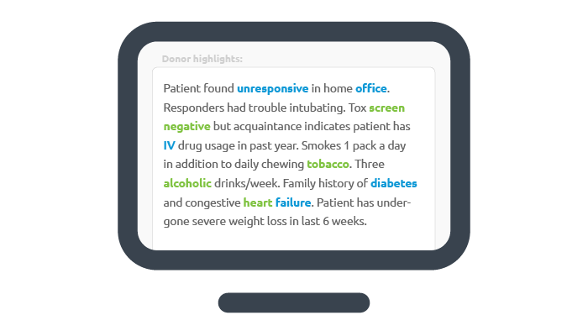
Natural Language Processing: Unlocking insights in free-text fields
Natural Language Processing (NLP) a set of techniques that can “make sense” out of free-text data
A number of free-text fields, such as Donor Highlights, may contain additional insights that could affect organ utilization
Notes:
Couple of notes:
DonorNet has several free-text fields—including Donor Highlights, Admission Course, and Social History
Free text fields, known as unstructured data, may contain a number of insights
Left is an illustrative example of the types of text we may see

Slide 9
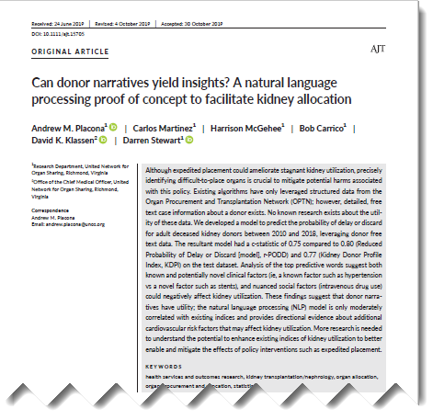
NLP in Transplant
Analyzed 8 years of adult kidney donor data from DonorNet
Free-text fields
Admission course history
Donor medical and social history
Donor highlights

Slide 10
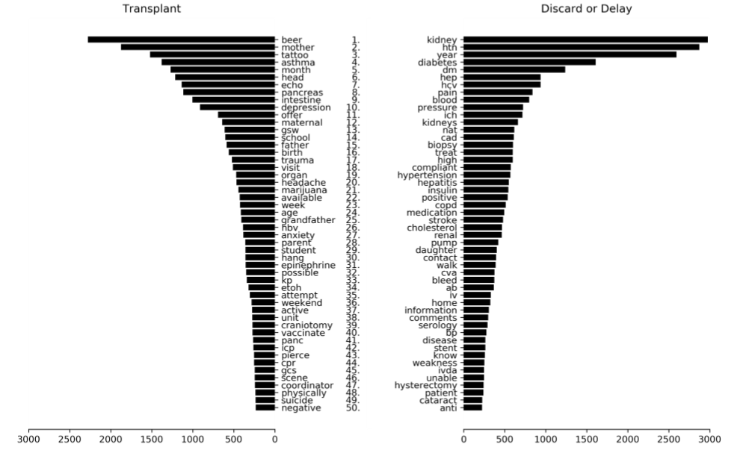

Slide 11
There are potential nuanced social and cardiovascular factors that are not being systematically captured within our structured form data
Examples of Social History |  |  | Examples of Cardiovascular Factors
Word | Impact on Discard Probability | Within DDR/DonorNet | Word | Impact on Discard Probability | Within DDR/DonorNet
Beer |  | Alcohol Use* | Stent |  | No
Tattoo |  | No | Cholesterol |  | No
IVDA/IV |  | Yes* | CPR |  | Yes
Marijuana |  | No | CAD |  | No
Notes:
Couple of notes:
Social History—turns out that our drug usage field (right now its IV or Other) could be improved. Knowing an individual’s drug use is marijuana may reduce the probability that a kidney discarded
Tattoo could be associated with PHS increased risk, but is not the same type as other types of increased PHS risk
We do not collect data on Stents, Cholesterol, or CAD; a number of cardiovascular risk factors may affect physician decision-making and is more likely if we have older donors in our donor pool.

Slide 12
How can NLP be used in transplant
Potential Use Cases:
Leveraging NLP to structure key details from donor highlights, donor admissions, and donor social/medical history
Utilizing NLP to understand potential data collection
Assessing whether NLP could enable automated form generation from transplant centers and OPOs
Extracting medical details from ultrasound and imaging studies where subjective narratives are provided
Assessing trends and consistency within exception requests via NLP

Slide 13
Questions
Which of these use cases could benefit the organ transplant most?
Are there other applications where NLP could reduce data collection burden?
Are there questions or problems, either candidate or donors, could tackled with NLP?

Slide 14
Predictive Analytics

Slide 15
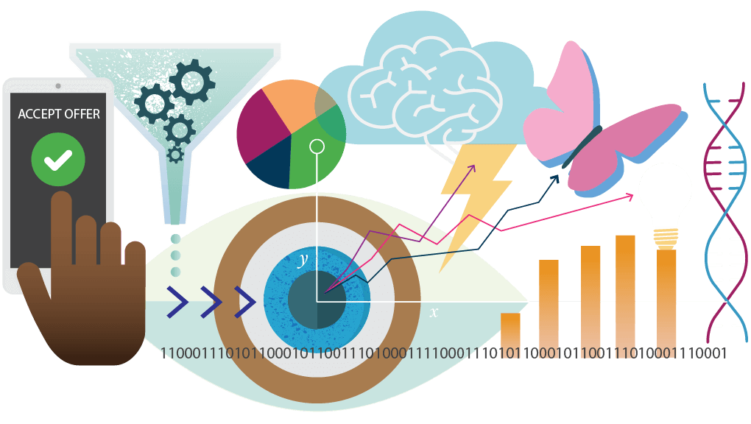
Notes:
Evaluating a deceased donor organ offer is a complex process that relies heavily on the decision-makers intuition, previous experiences, and clinical expertise.
When evaluating an organ offer, decision-makers need to assess quality of the available organ, patient stability, transplant center priorities, regulatory concerns, and patient preferences, while also considering whether the patient will receive a similar or better offer in the future.
Decision-makers use this information to try and calculate the risks and benefits of accepting an organ offer.

Slide 16
Ad Hoc Systems Performance Committee
During the March 2019 in-person meeting, prioritized new tools and resources to support offer review and decision-making process, to include predictive analytics
SPC Prioritized Predictive Analytics at Organ Offer
Predicted graft survival (median years of graft life) for this candidate with this organ
Net benefit of transplant (survival with vs. without transplant) for this candidate with this organ
Predicted patient survival if declining this offer but remaining on the waitlist
Predicted impact on your program’s 1 year graft and patient survival observed-to-expected ratio (O/E) of performing this transplant
Predicted difference in likelihood of having a functioning graft in 3 years by accepting this organ vs. waiting for another
Notes:
During their March 2019 in-person meeting, the Ad Hoc Systems Performance Committee (SPC) came to a consensus on a prioritized list of new tools and resources to support the offer review and decision-making process.
Included in this list were predictive analytics, and a list of the most impactful analytics identified for organ offer evaluation are listed in Table 1 below. The SPC believes that advanced Clinical Decision Support, in the form of predictive analytics within the match run, could improve offer acceptance, although evidence supporting this idea is limited.

Slide 17
UNOS Labs – Predictive Analytics Project Goals
Assess how clinical decision-makers currently evaluate organ offers
What predictive analytics do they currently use?
What estimations are they making?
What are the current attitudes and beliefs regarding predictive analytics?
What patterns of workflow currently exist?
Determine the value of predictive analytics as clinical decision support, and how they may impact the system and organ offer decision-making
What impact do predictive analytics have on decision-making?
What impact do predictive analytics have on intra-doctor and between doctor variability?
Notes:
There is therefore, a need to support clinical decision-making, and a call from the community for these tools to include predictive analytics at the time of organ offer. The ultimate goal of this multi-phase project is to gather evidence to support a successful implementation of predictive analytics into UNOS systems.
This multi-phase project has two overarching goals. The first goal is to have a more comprehensive understanding of how clinical decision-makers evaluate organ offers. This foundational work will inform potential changes to the system, inclusive of the addition of predictive analytic tools.
The second goal will be to determine the value of predictive analytics as clinical decision support, and how it may impact the system and organ offer decision-making.

Slide 18
Study Phases
Phase I
Phase II
Phase III
Phase IV
Survey to assess decision-makers’ attitudes, beliefs and current practices in predictive analytics
(Feb/March)
Key Informant Interviews to understand adult kidney offer evaluation process how decision-makers prioritize offer information
(Feb/March)
Onsite, cognitive interviews of simulated kidney offers
(April/May)
Cognitive interviews of simulated offers with a clinical decision support dashboard
(ATC – June)
SimUNet study with various PA tools to determine how they change acceptance behavior
(Aug/Sept)

Slide 19
Outcomes
Final report to the UNOS Board of Directors December 2020
A framework for successfully implementing clinical decision support for real offers
A more comprehensive understanding of the kidney organ offer evaluation process with insight on how members prioritize and examine data in the system, potentially informing future design changes to DonorNet.

Slide 20
Questions
What concerns do you have regarding the use of predictive analytics to inform organ offer decision-making?
What predictive analytics do you wish you had access to?
What calculators or predictive analytics are you currently using to inform organ offer decision-making?

Slide 21
If you are interested in participating in any phase of this research project please reach out to project lead,
Laura Cartwright
Laura.Cartwright@unos.org

Slide 22
April 6-8 Bellagio Hotel Las Vegas, Nevada

