Slide 1
Monitoring our Success: Data Update, Collaborative Goals
Region 9 Collaborative New York Academy of Medicine
3/19/19

Slide 2
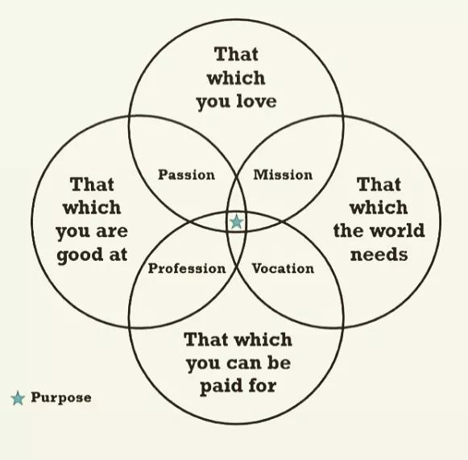

Slide 3
National Data 2014-2018
Deceased Donation Increase 4.2% ‘17-’18
Living Donation Increase 10.5% ‘17-’18

Slide 4
National Data 2014-2018
Deceased Donor Transplant Increase 4% ‘17-’18
Living Donation Transplant Increase 10.5% ‘17-’18

Slide 5
Goals of the Region 9 Collaborative
Committed to saving or enhancing lives by spreading known best practices to the region’s hospitals, to improve organ donation rates
Measures:
Increase Eligible Donor Conversion Rate
Increase Total Donor Conversion Rate
Increase Transplanted Organs per Donor
Surpass 500 Donors in Region 9 in CY 2018

Slide 6
Region 9 OPO Performance 2017-2018
Donation Service Area - Total Donors | 2017 | 2018 | Net Change | Net Change %
NYAP Center for Donation and Transplant | 63 | 54 | -9 | -14%
NYFL Finger Lakes Donor Recovery Network | 48 | 58 | 10 | 21%
NYRT LiveOnNY | 296 | 313 | 17 | 6%
NYWN Upstate NY Transplant Services | 51 | 55 | 4 | 8%
Total Region 9 | 458 | 480 | 22 | 5%
Donation Service Area – Total Organs Transplanted | 2017 | 2018 | Net Change | Net Change %
NYAP Center for Donation and Transplant | 162 | 133 | -29 | -18%
NYFL Finger Lakes Donor Recovery Network | 111 | 187 | 76 | 68%
NYRT LiveOnNY | 851 | 879 | 28 | 3%
NYWN Upstate NY Transplant Services | 155 | 133 | -22 | -14%
Total Region 9 | 1279 | 1332 | 53 | 4%
Donation Service Area – Yield per Donor | 2017 | 2018 | Net Change | Net Change %
NYAP Center for Donation and Transplant | 2.57 | 2.46 | -0.11 | -4%
NYFL Finger Lakes Donor Recovery Network | 2.31 | 3.22 | 0.91 | 39%
NYRT LiveOnNY | 2.88 | 2.81 | -0.07 | -2%
NYWN Upstate NY Transplant Services | 3.04 | 2.42 | -0.62 | -20%
Total Region 9 | 2.79 | 2.78 | -0.01 | 0%

Slide 7
Region 9 OPO Performance 2019 Jan-Feb
Donation Service Area - Total Donors | 2018 | 2019 | Annualized ‘19
NYAP Center for Donation and Transplant | 7 | 17 | 102
NYFL Finger Lakes Donor Recovery Network | 9 | 12 | 72
NYRT LiveOnNY | 59 | 50 | 300
NYWN Upstate NY Transplant Services | 6 | 9 | 54
Total Region 9 | 81 | 88 | 528
Donation Service Area – Total Organs Transplanted | 2018 | 2019 | Annualized ‘19
NYAP Center for Donation and Transplant | 15 | 40 | 240
NYFL Finger Lakes Donor Recovery Network | 26 | 42 | 252
NYRT LiveOnNY | 140 | 153 | 918
NYWN Upstate NY Transplant Services | 10 | 15 | 90
Total Region 9 | 191 | 250 | 1500
Donation Service Area – Yield per Donor | 2018 | 2019 | Annualized ‘19
NYAP Center for Donation and Transplant | 2.14 | 2.35 | 2.35
NYFL Finger Lakes Donor Recovery Network | 2.89 | 3.50 | 3.50
NYRT LiveOnNY | 2.37 | 3.06 | 3.06
NYWN Upstate NY Transplant Services | 1.67 | 1.67 | 1.67
Total Region 9 | 2.36 | 2.84 | 2.84

Slide 8
Region 9 Transplanted Organs
 | 2016 | 2017 | 2018 | Net Change 2017-2018
Deceased Donor Transplants from Region 9 OPOs at Region 9 Centers | 958 | 1,040 | 1,051 | 11 (+1%)
Imports from other OPOs Transplanted at Region 9 Centers | 673 | 667 | 878 | 211 (+32%)
Total Deceased Donor Transplants at Region 9 Centers | 1,631 | 1,707 | 1,929 | 222 (+13%)
Living Donor Transplants | 541 | 552 | 705 | 153 (+28%)
Total All Transplants at Region 9 Centers | 2,172 | 2,259 | 2,634 | 375 (+17%)
Exported & Transplanted Outside of Region 9 | 237 | 239 | 281 | 42 (+18%)

Slide 9
Takeaways: Region 9 YOY Performance 2017-2018
Increase in Total Deceased Donors and Total Deceased Donor Organs Transplanted Mirrors National Data
Living Donors increased significantly in 2018; Exceeded National Data
OPO Performance was mixed; Donor Yield Flat
Congratulations to FLDRN and LiveOnNY for an outstanding 2018!
Key Drivers in Transplant Volume Growth:
Increase in Living Donor Transplants
Increase in Imported Deceased Donor Transplants
Exported Deceased Donor Organs increased but greatly outweighed by key drivers above

