Slide 1
Organ Allocation Update: Lung and Heart Region 5 Collaborative Las Vegas, Nevada August 21, 2019 Maryl Johnson, MD President, UNOS/OPTN Board of Directors

Slide 2
Legal Involvement In Organ Allocation/Distribution

Slide 3
Pediatric Lung
2013
Challenge to the Pediatric Lung allocation policy to allow pediatric
recipient to have LAS score and compete with adolescents/adults
Critical comments letter sent to HHS asking for prompt review of
Pediatric Lung Allocation Policy
Lawsuit filed requesting TRO to cease application of the Under 12 rule
OPTN Executive Committee creates LRB exception allowing candidates
aged 0-11 to be listed as adolescents (with sunset in 1 year)
2014
OPTN Board makes this exception process permanent
PRECEDENT SET:
Critical Comments as a path for legal action
Federal court grants a TRO leading to OPTN Policy change

Slide 4
Adult Lung
November, 2017
Critical comment submitted to HHS requesting removal of DSA from lung allocation policy making initial distribution a 500 NM circle
Lawsuit filed in federal court requesting a TRO.
Court requests emergency review of lung policy stating use of DSA as allocation unit is arbitrary and capricious (inconsistent with the Final Rule)
Revised policy implemented under the OPTN Emergency Policy Pathway making initial distribution a 250 NM circle
Policy subsequently approved by the OPTN Board in June, 2018
PRECEDENT SET: Judicial intervention influences the OPTN to make a rapid and significant change to allocation policy
PRECEDENT SET:
Judicial intervention influences the OPTN to make a rapid and significant change to allocation policy

Slide 5
Update on the Revised Lung Allocation System (1 year pre vs post broader distribution)

Slide 6
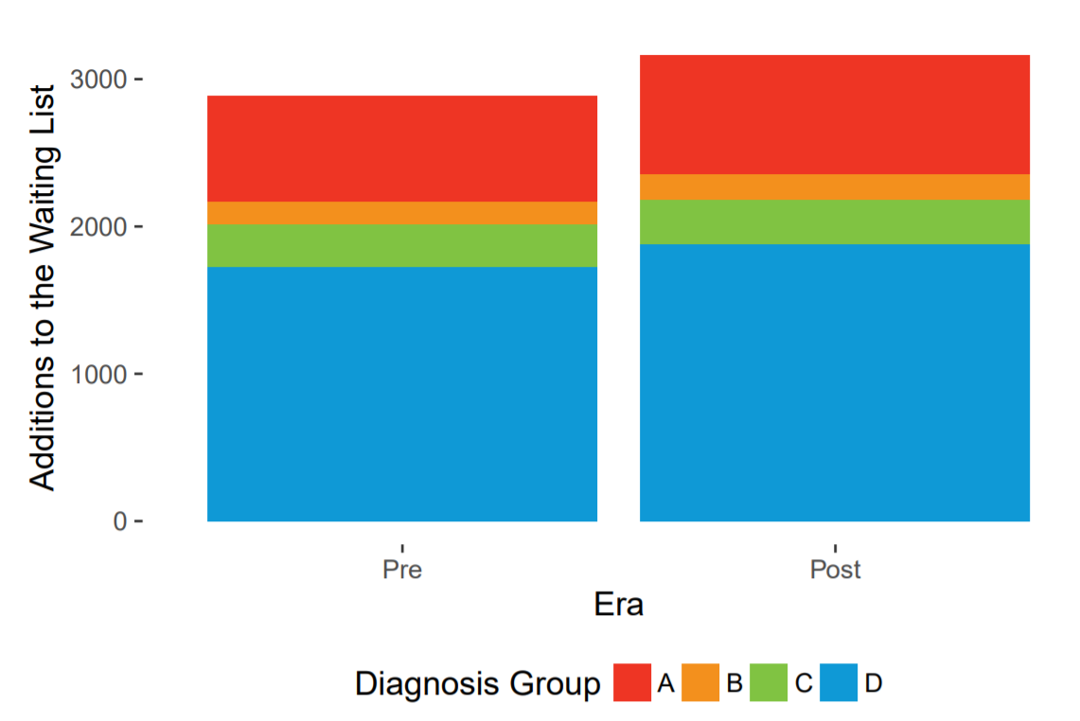
Candidates Added to the Waiting List by Diagnosis Group

Slide 7
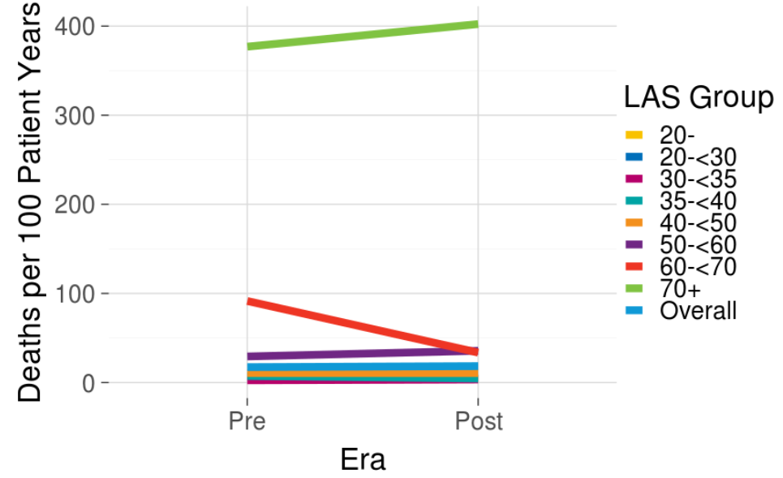
Deaths per 100 Patient Years While Waiting by LAS Group

Slide 8
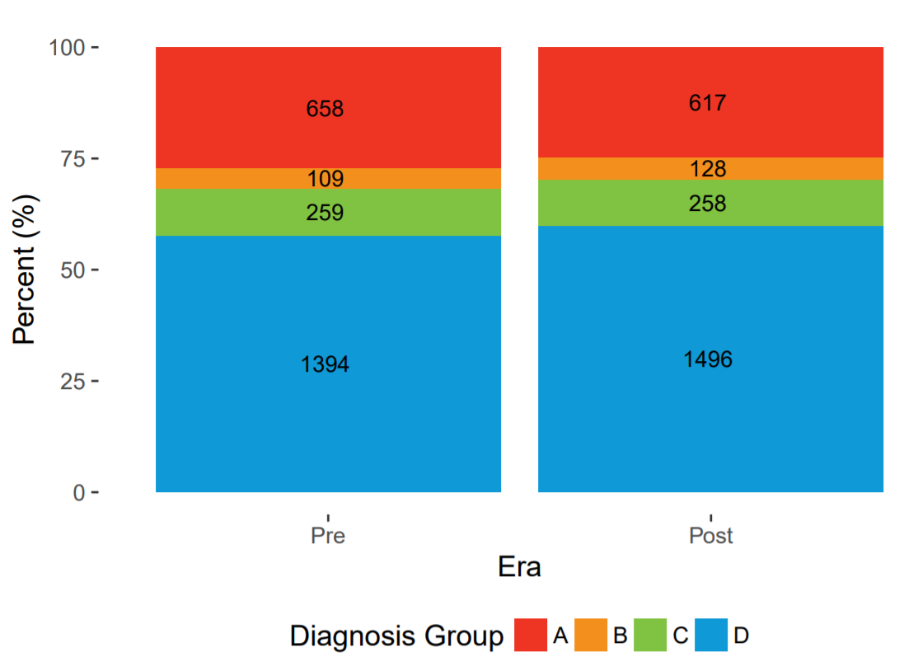
Deceased Donor Lung Transplants by Diagnosis Group
Notes:
* Note that there we no statistically significant changes in the transplant rate by diagnosis group or LAS group.

Slide 9
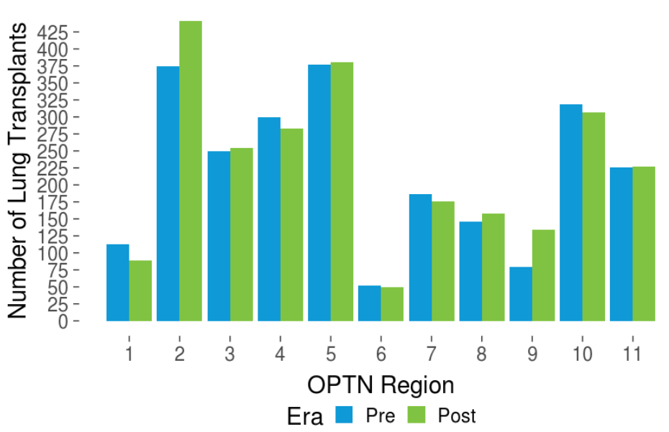
Deceased Donor Lung Transplants by OPTN Region

Slide 10
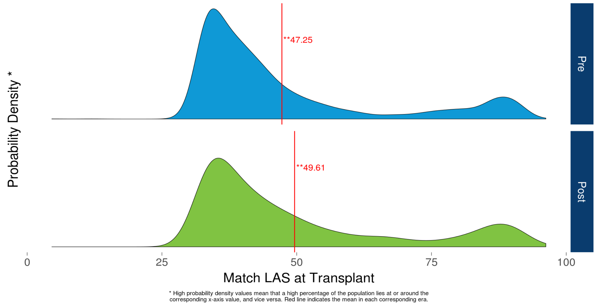
Transplant Recipients by LAS
Notes:
Background:
This figure shows the distribution of match LAS at transplant
Findings:
The average match LAS at time of transplant for the pre era is 47.25 and 49.61 for the post era.
There is a statistically significant difference between the mean LAS in the pre era compared to the post era
The OPTN Thoracic Committee discussed whether this was a clinically meaningful increase. Committee members commented than over a 2 point increase did represent a clinically sicker population receiving transplants.
Additionally, there were 340 recipients with a LAS of at least 75 in the pre era and 397 in the post era.

Slide 11
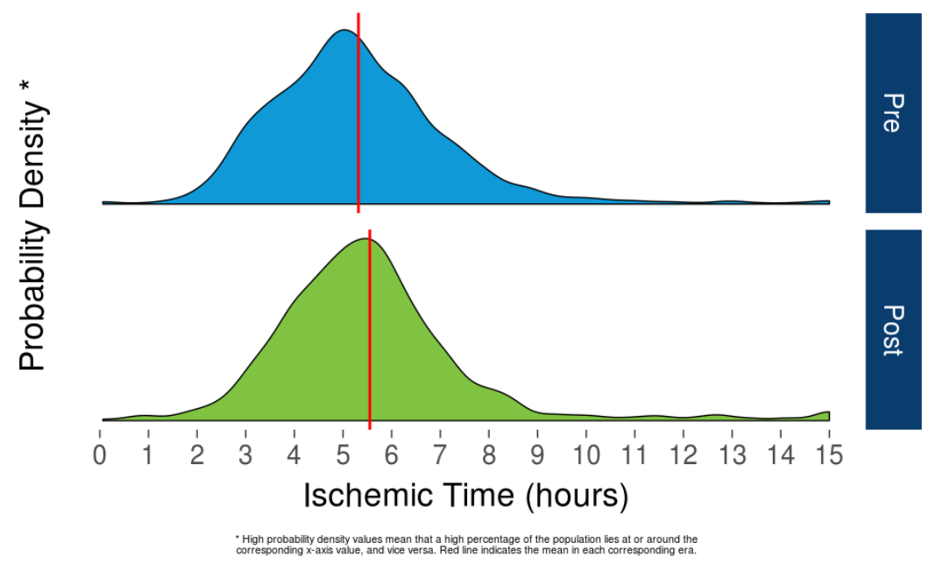
Ischemic Time (Cold, Warm, Anastomotic Time)
Notes:
5.32 hours to 5.55 hours; 12 minutes; statistically significant

Slide 12
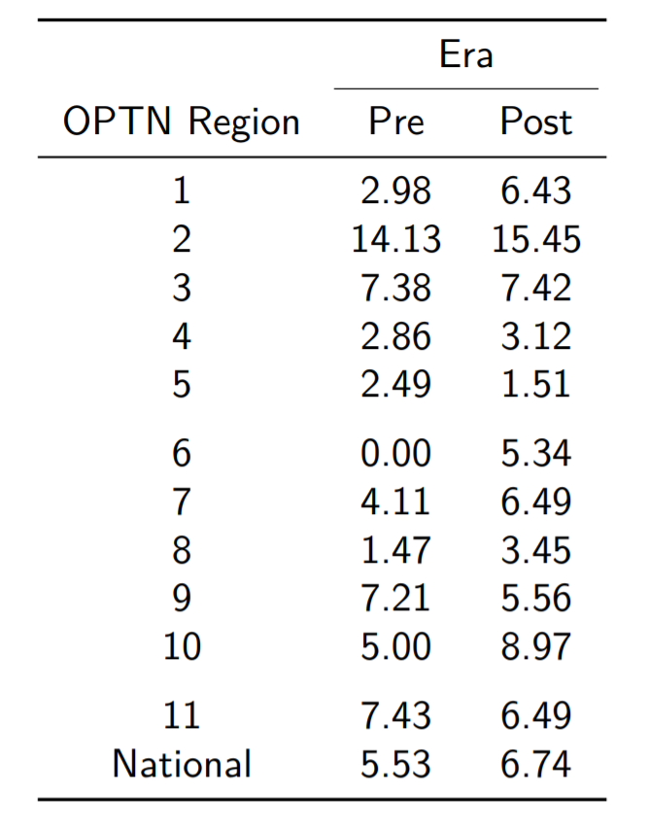
Discard Rate by OPTN Region
Notes:
Effect of DCD; Ex-vivo

Slide 13
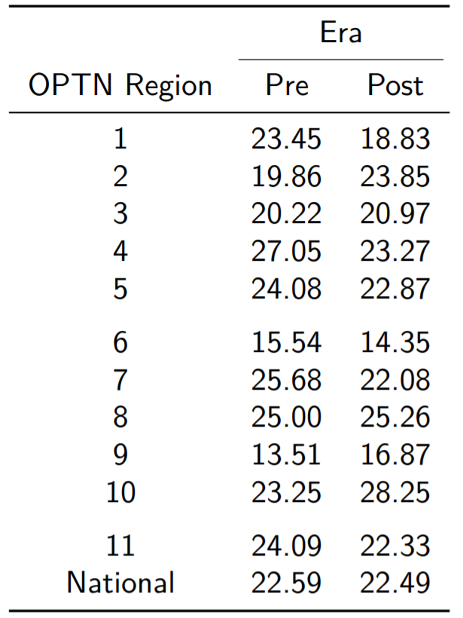
Utilization Rate by OPTN Region
Notes:
Ex vivo perfusion doubled nationally – 122-266; 0 to 15 in Region 5

Slide 14
Other Metrics One Year Following Changes to Lung Allocation
Increased # of additions to the wait list
2,887 to 3,165
Increased median distance from donor hospital to transplant center
114 NM to 166 NM
Increased overall ischemic time
5.32 to 5.55 hours
Increase in the number of lung transplants
2,420 to 2,499
Notes:
Recall this went into effect November 24, 2017.
Draw attention to Increase in mean match LAS at transplant: 47.25 to 49.61
Increase in median distance: 114 to 166 NM
Thoracic Committee watching the increase in overall ischemic time. Includes cold time, warm time and anastomosis time

Slide 15
Geography
Notes:
From an upcoming memo to the community – doesn’t need to be word for word, but this is what we’re trying to express by including geography – again – in the leadership update:
I’d like to update you on the recent and ongoing efforts to improve transplant access by updating the criteria used in geographic organ distribution. I know many of you have been involved in at least one, if not more, of these initiatives. Thanks to all of you who have taken part in the policy development process to make these needed changes.
This will be a continuing journey for the foreseeable future. It is true that we must end our reliance upon dated, fixed boundaries of donation service areas (DSAs) and regions. But in so doing, we can and should address take the broader opportunity to improve our organ allocation systems. The more we learn about the factors that affect transplant access, the more deliberate we can be in reducing variation in access for all of the patients we serve.
Here is an update on the various initiatives in geographic distribution. We welcome your feedback and participation in the current and future stages.

Slide 16
Geography next steps
Organizational commitment to ensure all future changes to geographic allocation are in alignment with the final rule
Board resolution designating continuous distribution as the preferred model for distribution
Lung – DSA removed, continuous distribution concept document released
Heart – Board approved new policy replacing DSA with 250 NM circle for first unit of allocation, awaiting programming
Notes:
Also from the upcoming memo:
Lung (continuous distribution concept paper)
The OPTN Board of Directors resolved in December 2018 that the eventual goal of organ distribution policy is “continuous” distribution. While distance from donor hospital to transplant hospital will be considered in a weighted system, no fixed geographic boundaries will distinguish “local” and “non-local” candidates.
To that end, the Thoracic Organ Transplantation Committee has published for public comment a concept paper to explore lung distribution based on the continuous distribution model. This is not a formal policy proposal. It is an initial investigation of how continuous distribution may apply. Just as with any policy proposal, we want and need your feedback as we investigate this future approach that will serve as a basis for all organ systems.
Heart and VCA
The OPTN Board approved two measures at its June 2019 meeting to replace organ allocation systems based on DSA or region.
For heart allocation, the “local” distribution area will become the transplant hospitals within 250 nautical miles of the donor hospital, instead of the DSA where the donor hospital is located. This will make local heart distribution equivalent with the local lung distribution area already established for lung allocation. This policy is expected to take effect in November 2019.
VCA distribution will now begin with compatible candidates listed at transplant hospitals within a 500 nautical mile distance from the donor hospital, replacing the previous use of the OPTN region as the first level of matching. This policy is expected to take effect in June 2020.
Liver and intestinal organs
In December 2018, the OPTN Board of Directors approved a liver and intestinal organ allocation system to replace donation service area (DSA) and regional boundaries with a distribution system based on acuity circles. The acuity circle model compares the candidate’s medical urgency with the distance between the donor hospital and the transplant hospital where the candidate is listed.
Implementation of the acuity circles approach has been postponed by order of a federal court, which is evaluating a legal challenge to the policy development process. We have implemented the National Liver Review Board (NLRB). For now, with the postponement of acuity circle distribution, calculation of the median MELD at transplant (MMaT) for exception candidates is based on transplants at the DSA where the candidate is listed.
While we do not know the timeline for the conclusion of the legal proceedings, we are confident that the deliberate process undertaken by the Liver Committee and the Board will be upheld by the court and the policy will ultimately be implemented to redirect livers to the sickest patients regardless of where they may reside
Kidney and pancreas
The Kidney Transplantation and Pancreas Transplantation Committees have issued proposals for public comment to replace the DSA/regional/national matching system. Their recommended approach combines circle-based distribution with proximity points for candidates. Patients at transplant centers closer to the donor hospital would get proportionally more proximity points than those at more distant hospitals.
Please take the opportunity to learn about and provide feedback on these proposals, whether directly through the public comment site, at your regional meeting or via a policy webinar. We need and welcome your expertise and views to develop policies that will result in the best possible access for all transplant candidates.

Slide 17
Update on the Revised Heart Allocation System

Slide 19
New Heart Status/Criteria
New Status | Status Descriptions | Admission Required | Days Valid | Extension Eligible | Previous Status
1 | VA ECMO | Y | 7 | RRB* | Subsets of 1A and 1B(aa)
 | Non-dischargeable, surgically implanted, non-endovascular biventricular support device | Y | 14 | Y
 | MCSD with life-threatening ventricular arrhythmia | Y | 14 | Y
2 | Non-dischargeable, surgically implanted, non-endovascular LVAD | Y | 14 | RRB | Subsets of 1A and 1B(aa)
 | Total artificial heart, BiVAD, RVAD or VAD for single ventricle | N | 14 | Y
 | MCSD that is malfunctioning | Y | 14 | Y
 | Percutaneous endovascular circulatory support device | Y | 14 | RRB
 | Intra-aortic balloon pump | Y | 14 | RRB
 | Recurrent or sustained ventricular tachycardia or ventricular fibrillation | Y | 14 | Y
*RRB = Regional Review Board

Slide 20
New Status/Criteria (Cont.)
New Status | Status Descriptions | Admission Required | Days Valid | Extension Eligible | Previous Status
3 | Dischargeable LVAD for up to 30 days | N | 30 | N | i. Subsets of status 1A
 | Multiple inotropes or single high-dose inotropes with continuous hemodynamic monitoring | Y | 14 | Y
 | Mechanical circulatory support with hemolysis, pump thrombosis, right heart failure, device infection, bleeding, AI | Y bleeding; rest N | 14-90 | Y
 | VA ECMO >7 days; non-dischargeable surgically implanted non-endovascular LVAD, percutaneous support device, or IABP> 14 days | Y | 7-14 | Y
4 | Dischargeable LVAD | N | 90 | Y | Status 1B
 | Inotropes without hemodynamic monitoring | N | 90 | Y
 | Congenital heart disease (CHD) eg: | N | 90 | Y
 | a. Unrepaired/incompletely repaired complex CHD
 | b. Repaired CHD with two ventricles (e.g., TOF, TOGV)
 | c. Single ventricle repaired with Fontan or modifications
 | iv. Ischemic heart disease with intractable angina | N | 90 | Y
 | v. Amyloidosis, hypertrophic cardiomyopathy or restrictive cardiomyopathy (with clinical qualifiers) | N | 90 | Y
 | vi. Retransplant | N | 90 | Y

Slide 21
New Status/Criteria (Cont.)
New Status | Status Descriptions | Admission Required | Days Valid | Extension Eligible | Previous Status
5 | Combined organ transplants: heart-lung; heart-liver; heart-kidney | N | 180 | Y | NA
6 | All remaining active candidates | N | 180 | Y | Status 2
Inactive | Inactive/unable to undergo transplant | NA | NA | NA | Inactive

Slide 22
SEQUENCE OF ADULT (> 18) HEART ALLOCATION
Zone A (500 nautical miles)
1. Status 1 candidates
2. Status 2 candidates
DSA (to become 250 nautical miles)
3. Status 3 candidates
Zone B (500 - 1,000 nautical miles)
4. Status 1 candidates
5. Status 2 candidates
DSA (to become 250 nautical miles)
6. Status 4 candidates
… etc.

Slide 23
2018 Heart Allocation Modifications
Changes implemented October 18, 2018
This report: October 18, 2018 – February 17, 2019 (four months)
Comparison period: October 18, 2017 – February 17, 2018
Areas of Focus:
New medical urgency statuses
Broader sharing
Further details available in full report

Slide 24
Waiting List
1252 adult registrations added post-implementation vs 1313 pre-implementation
4731 adults ever waiting post-implementation vs 4907 pre-implementation

Slide 25
Waiting List Additions by Status and Era

Slide 26
Waiting List Additions by Region and Era

Slide 27
Transplant
909 adult heart transplants post-implementation vs 918 pre-implementation

Slide 28
Transplants by Status and Era

Slide 29
Transplants by Region and Era

Slide 30
Distance Traveled by Era
Notes:
Pre median 84 nm, post median 223 nm

Slide 31
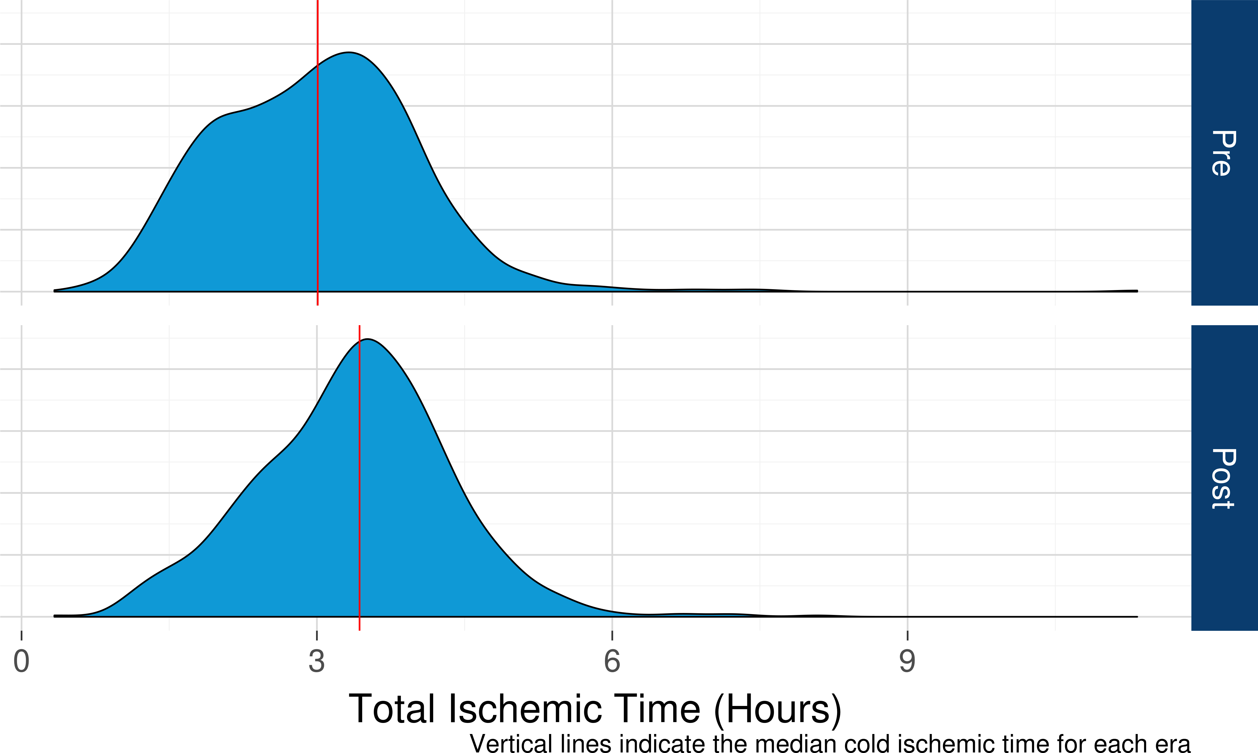
Total Ischemic Time by Era
Notes:
IT 3 hours pre, 3.4 post; statistically significant

Slide 32
Utilization
2640 non-DCD deceased donors recovered post-implementation vs 2656 pre-implementation

Slide 33
Heart Utilization Rates for Non-DCD Deceased Donors by Region and Era

Slide 34
Conclusions
No substantial impact on waitlist additions, transplants performed, or utilization
Hearts are traveling farther to transplant
80+% of all exception requests approved regardless of reviewing region

Slide 35
Next steps
Ongoing monitoring is occurring and updated reports will be available in late 2019 or early 2020
Analysis needs to be extended to include posttransplant outcomes for the allocation/distribution changes for both lung and heart transplantation
Assessments to balance medical urgency vs efficiency/costs need to occur

