Slide 1
Liver and Intestinal Organ Transplantation Committee
Fall 2018

Slide 2
Projects and Policy Implementation Dates
National Liver Review Board (approved June 2017)
Enhanced Liver Distribution (approved December 2017)
Both affected by directive to remove DSA and region from allocation policy
Notes:
NLRB policy passed June 2017, including a new idea for scoring relying on the MMaT, in advance of a broader distribution policy which we had been working on since 2012.
Enhanced liver distribution policy passed board December 2017 which shared livers for patients with a MELD of 32 and higher in the region plus a circle around the donor hospital of 150 nautical miles.

Slide 3
Project and Policy Implementation Dates
Executive Committee directive
Legal challenge (letter to HRSA & lawsuit)
Compliance with the Final Rule
Concern for unintended consequences resulting from immediate change
Keep the decision making in the transplant community
Notes:
Timeline balances concern for unintended consequences with a need to bring policy into compliance and keep the decision in the transplant community
Policy challenged by a letter to HRSA May 30, 2018 (ultimately followed by a lawsuit filed in July)
Letter from HRSA Administrator to Dr. Becker received late Friday, June 8 which directed OPTN to offer its views on issues raised in the letter by June 25
Upon request by the Board, Liver committee provided feedback to the OPTN recommending adoption of the policy as written with a stepwise plan to continue to improve the system in order to preserve the process of policy development
OPTN Board agreed with the Liver Committee that the process of policy development is essential, but committed to creation of a new policy that does use DSA or region as a part of the system of allocation, using modeling and a special public comment cycle.

Slide 4
Project and Policy Implementation Dates
Removing DSAs and Regions from Liver Distribution (new project)
National Liver Review Board
Exception score basis changing
Liver Distribution/Allocation
Changing distribution
SRTR modeling of two concepts is currently underway
Notes:
New project will change both of the projects that were board approved and being programmed.
NLRB was based on MMaT in the DSA, and will be replaced with MMaT of candidates transplanted in a circle around the transplant hospital.

Slide 5
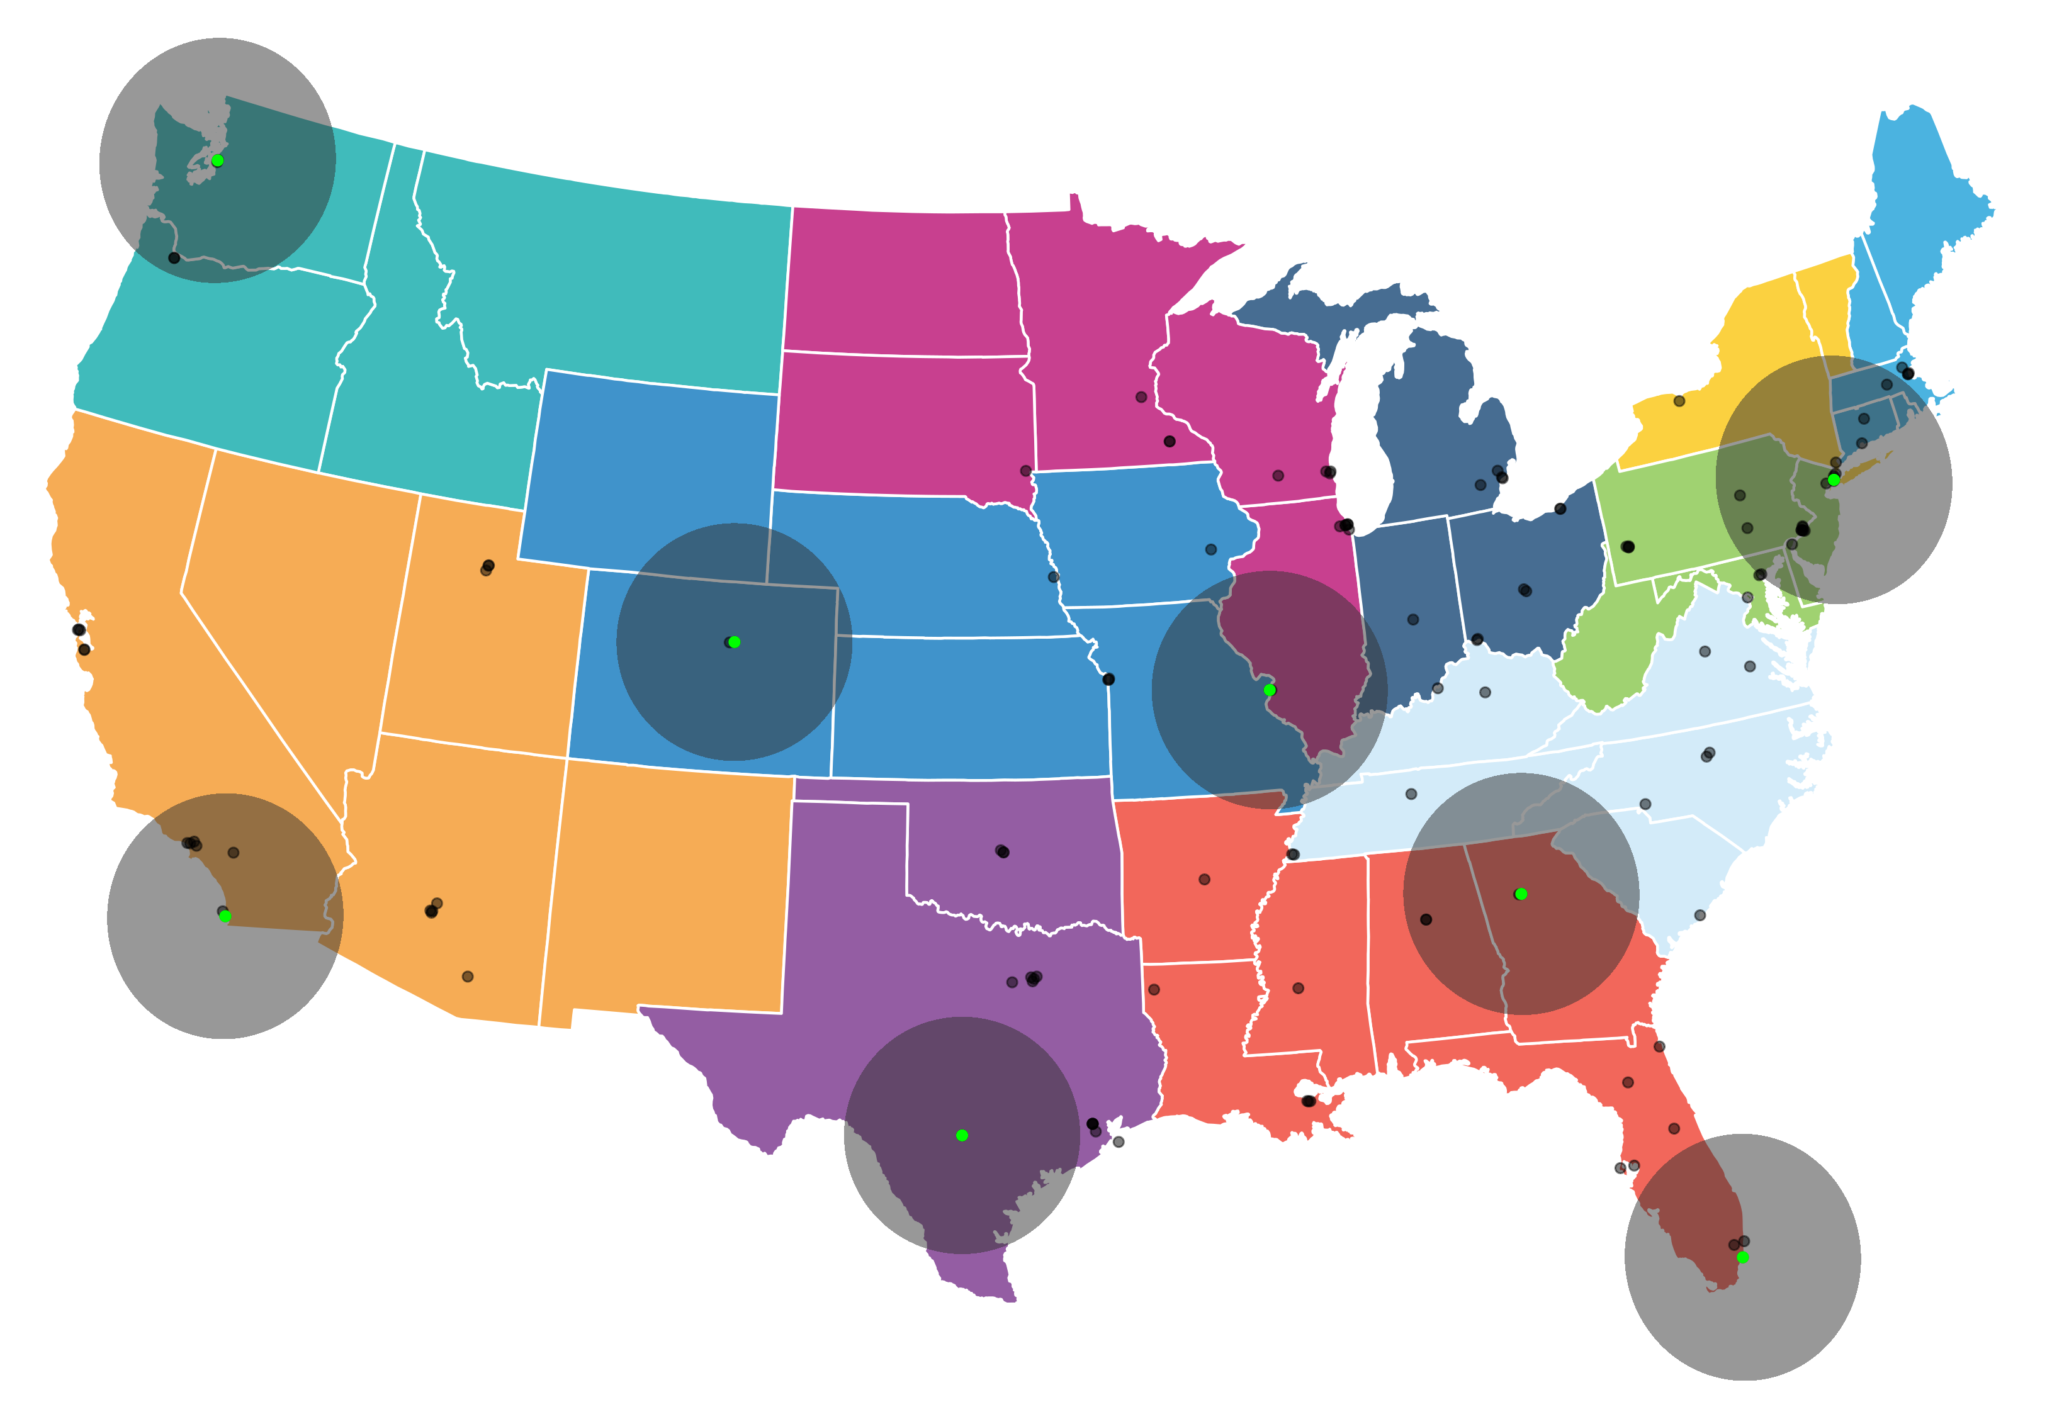
Exception Scoring
Committee anticipates replacing the concept of MMaT in the DSA with MMaT within a circle around the transplant hospital

Slide 6
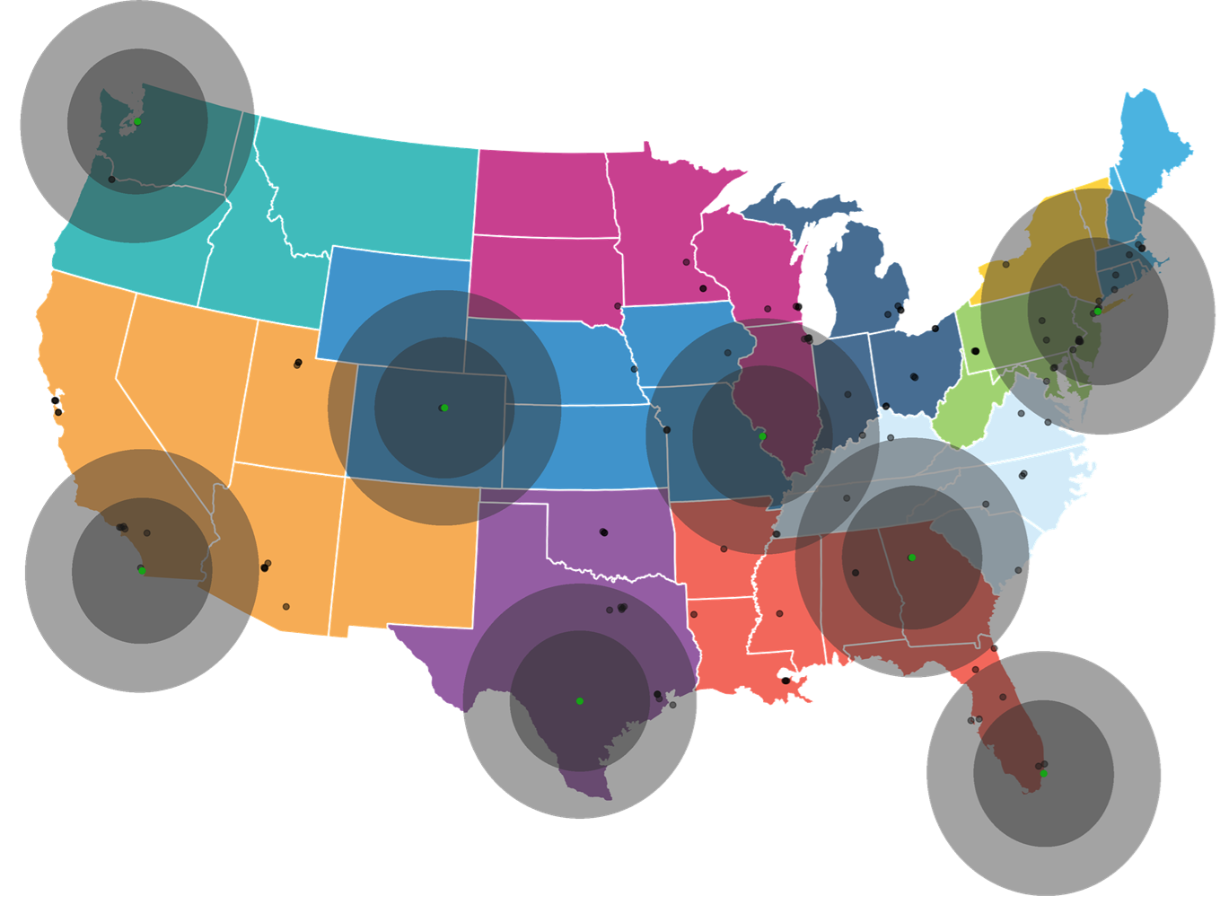
Distrubtion concepts being modeled
Both concepts utilize fixed distance circles around the donor hospital

Slide 7
Concepts being modeled
Both concepts include variations on 150, 250, 300, 500, and 600 mile circles
MELD/PELD sharing thresholds
Alternative allocation for DCD and age > 70 donors
Prioritize candidates in closer proximity
Increased priority for pediatric candidates with pediatric donors
Cap on exception scores
Notes:
Increased priority for pediatric candidates with pediatric donors being allocated to pediatric recipients in the circle and then nationally before adults

Slide 8
Other Changes Being Discussed
Simultaneous Liver Kidney (SLK) distribution
Removing OPTN Regions and DSA from liver policy requires modifications to SLK policy
Medical eligibility and safety net are unchanged
Liver-Intestine and Intestine Distribution
Circle based distribution

Slide 9
Timeline
Modeling available late September
Public comment October 8-November 1
National webinar and regional webinars
Board consideration December 3-4
Implementation Q1 2019
NLRB and Distribution may be separate or together
Education dates will be announced closer to implementation

Slide 10
Questions?

Slide 11
Supplementary Slides

Slide 12
Goals of the Liver Committee
Make a distribution policy that :
Improves disparity
Consideration for efficiency, logistics, impact on disadvantaged populations, and recognize the need to compromise
Is compliant with the final rule

Slide 13
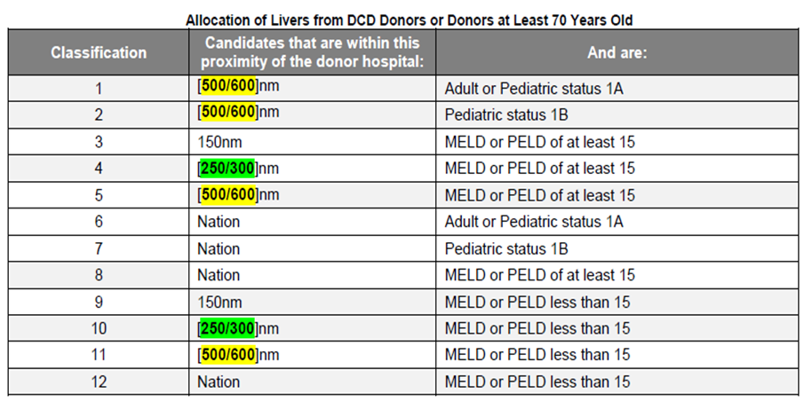
Current Modeling – Framework 1
Modeling 2 different combinations of circles
Ordered by MELD/PELD acuity
DCD/Age 70 donors – prioritize to candidates in close proximity

Slide 14
Framework 1
All pediatric candidates prioritized above adult candidates
No local priority for pediatric candidates in smaller circles

Slide 15
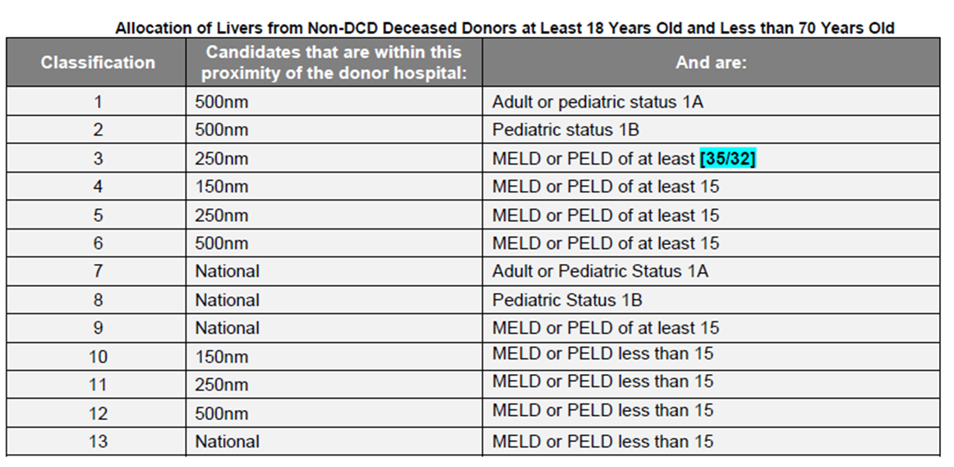
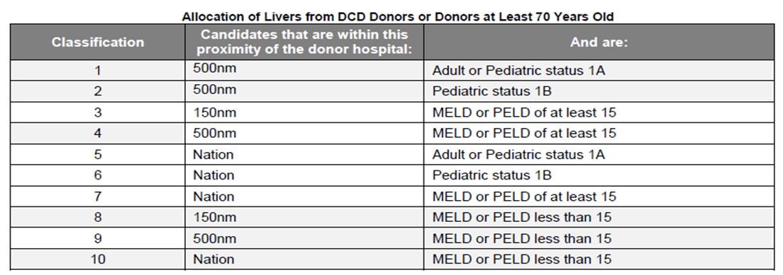
Current Modeling – Framework 2
500 mile circle for 1A/1B
250 nm circle for high MELD/PELD > 35
150 nm for > 15, then 250 and 500nm circles for MELD > 15
35 or 32 threshold

Slide 16
Framework 2
All pediatric candidates prioritized above adult candidates
No local priority for pediatric candidates in smaller circles

