Slide 1
UNOS Update and Future Geography Frameworks

Slide 2
MISSION
Advance organ availability and transplantation by uniting and supporting our communities, including transplant and organ donation professionals, patients and donor and recipient families, for the benefit of patients through education, technology and policy development.
VISION
Promote long, healthy and productive lives for persons with organ failure by promoting maximized organ supply, effective and safe care, and equitable organ allocation and access to transplantation.
VALUES
Stewardship
Unity
Trust
Excellence
Accountability

Slide 4
OPTN/UNOS Ad Hoc Committee on Systems Performance
August 2018-March 2019

Slide 5
Ad Hoc Committee on Systems Performance
Systems Performance Committee
Diane Brockmeier
Matt Cooper
Systems Dynamics Work Group
Jeff Orlowski, Stuart Sweet
OPO Work Group
Susan Gunderson, Tom Pearson
Transplant Program Work Group
Lisa Stocks, Alan Reed
Objective:
Identify and prioritize new and existing tools and strategies that allow the OPTN, transplant hospitals, and OPOs to drive improved system performance and collaborative improvement.

Slide 6
Committee Details & Potential Outcomes
55 community members
Three Work Groups
  2 Co-Chairs per Work Group (1 Transplant MD, 1 OPO)
Work Groups will meet monthly August-March
  October in-person
Public meeting in March in Chicago (Date TBD)
MPSC monitoring enhancements
Recommendations to external stakeholders
Collaborative improvement project ideas
Suggested new research tools

Slide 7
OPTN/UNOS Governance Structure:
How to Volunteer
Board, Committees, Regions
Notes:
We’ve had a number of questions lately about how to be considered for a Board, Committee or Regional volunteer position
This is a brief, high level overview of the process – if you have follow up questions or want to know more about a particular position, I encourage you to reach out to UNOS staff to discuss the details

Slide 8
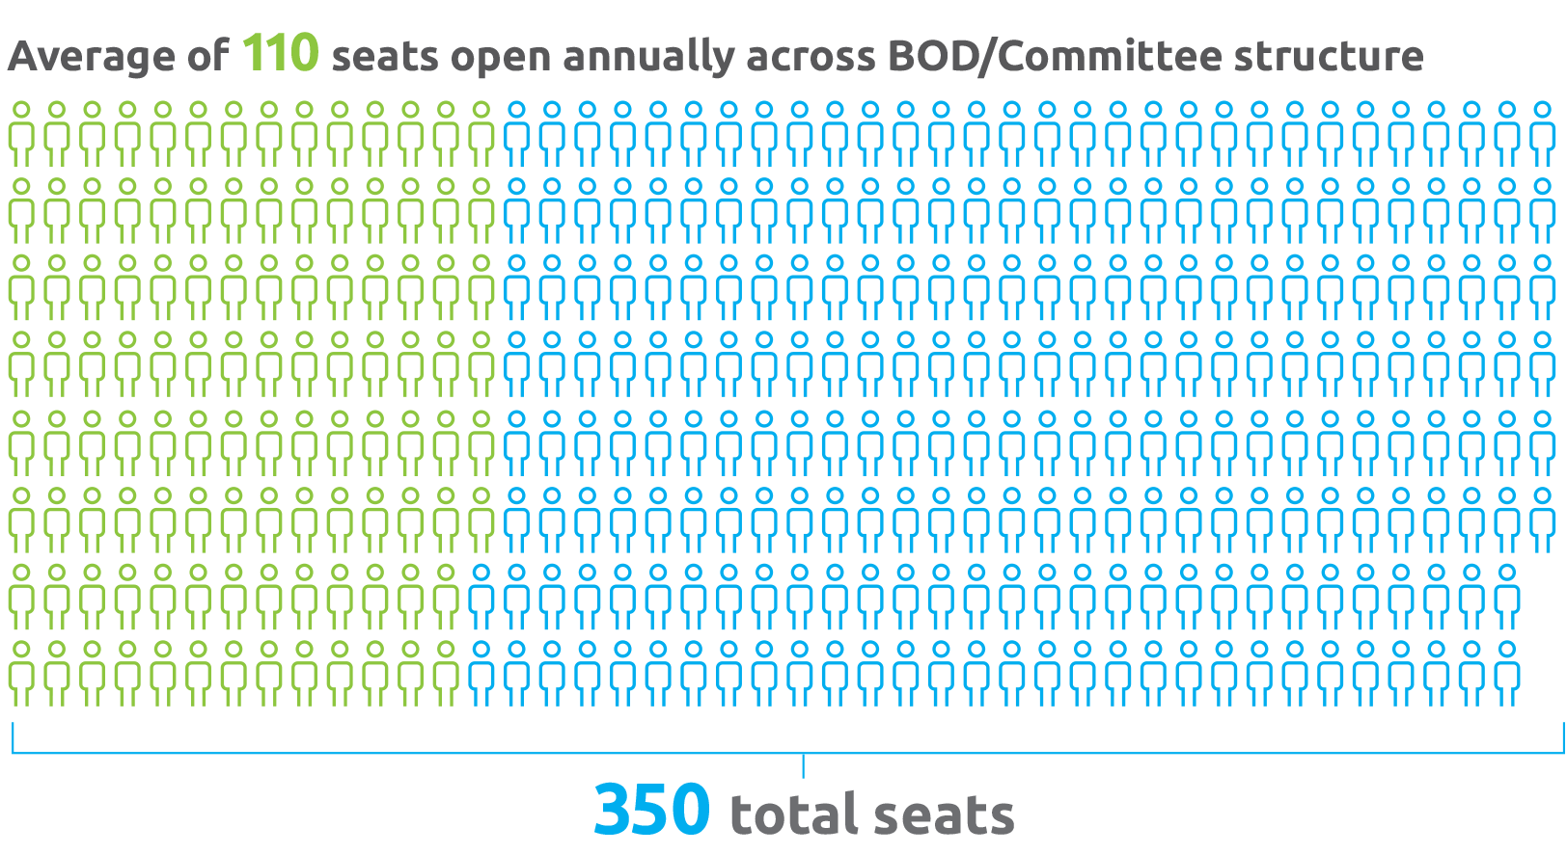
Volunteer Opportunities
Notes:
We work hard to ensure our volunteer perspectives come from a variety of professional disciplines, personal experience and expertise in organ transplantation and the community we serve
The overall composition of the committees and Board must reflect diversity in perspectives as well as race, ethnicity, and gender—plus specific committee needs for specialized expertise
Volunteering in the governance structure is not for everyone; takes commitment, deep experience
And not everyone can be on a committee…there’s a limited number of positions available
So while there are 350 total seats, only approximately 110 open each year, and we have strict criteria for filling those seats…

Slide 9
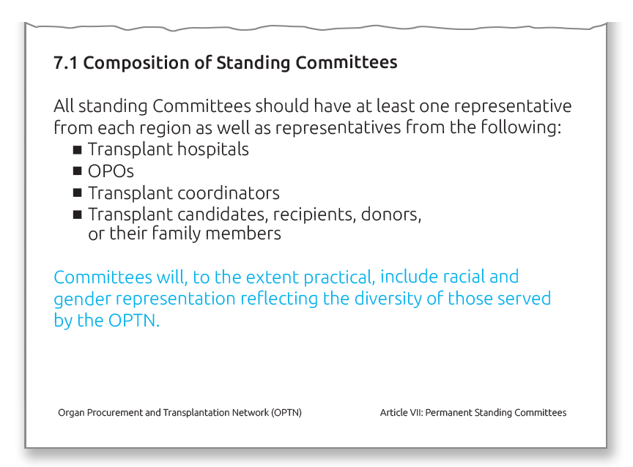
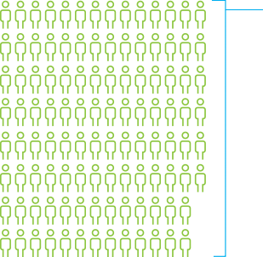
OPTN Bylaws
Notes:
Board and Committee composition is governed in part by the final rule and our own OPTN Bylaws
And we must reflect the diversity of the community we serve – not only ethnicity and gender, which are important, but different areas of practice, different professions within the field of transplant, and different sizes of transplant programs and OPOs
In order to ensure we’re compliant with the final rule and Bylaws requirements, we conduct an annual Board and Committees needs assessment prior to doing a call for nominations
The process is somewhat different for committee, regional, and Board openings. But in each case we’re intentional about seeing what the needs are and searching for motivated, experienced candidates to meet those needs.

Slide 10
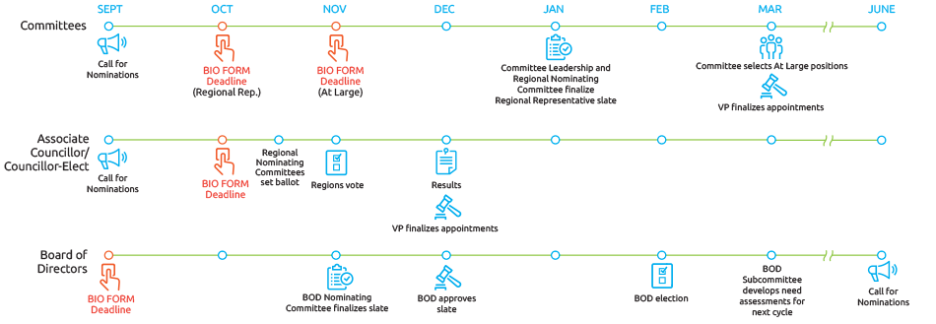
Governance Volunteer Positions: How to Apply
Notes:
Again, this is a high level overview of the process for volunteering for the Board, Committees and Regions.
The key takeaway here is that the OPTN/UNOS Bio Form is the key to serving on the Committee
Selections are based on needs of committee and the organization for diversity in perspectives and subject specific expertise
The OPTN/UNOS President-Elect ultimately reviews and approves all incoming committee members
The call for nominations for the 2019-2020 term is in your booklets, so please review that for all relevant details, including submission deadlines

Slide 11
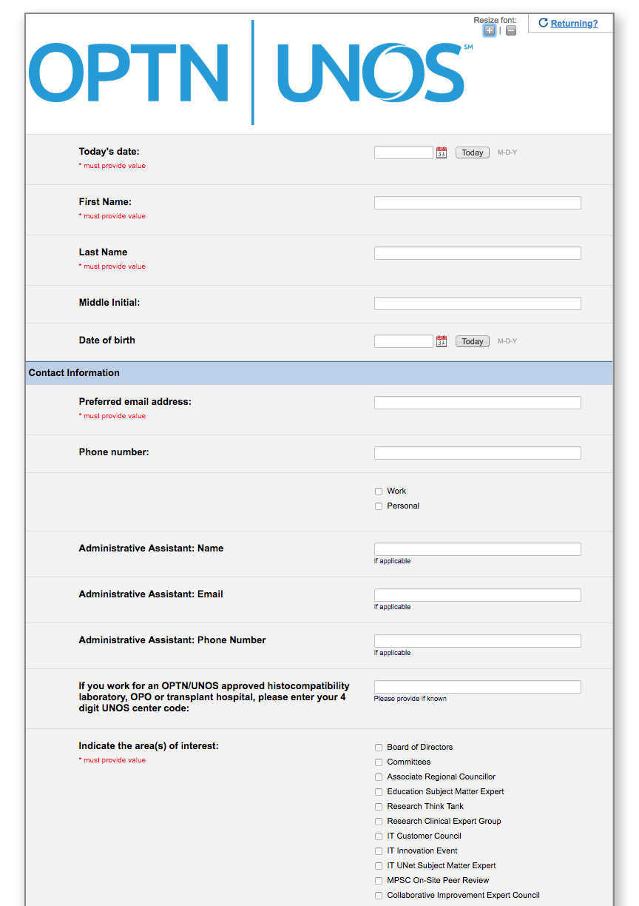
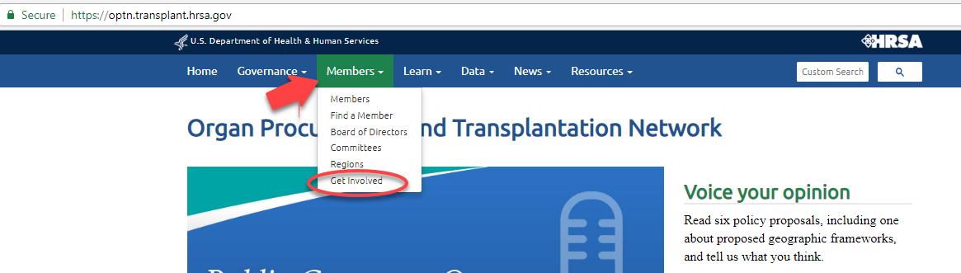
OPTN/UNOS Bio Form
Update your form annually to be considered for governance volunteer positions
http://optn.transplant.hrsa.gov/
Members > Get Involved
Notes:
The form is accepted on a rolling basis year-round, but you must submit one by the deadlines above to be considered within the upcoming cycle
Be sure to update your biography form annually to show your continued interest
Each committee with openings will review biography forms and make recommendations
Keeping your form updated will also ensure your name is available to UNOS staff in the event a vacancy needs to be filled mid-cycle due to resignations or moves
We also encourage professionals to refer recipients, donors and donor families to this form if you think they’d be well suited for Committee service

Slide 12
MPSC Lessons Learned

Slide 13
MPSC Lessons Learned
Reporting late-breaking donor test results (15.4.A) | PDF in UNOS Connect: "Reporting Patient Safety Events"
Disease transmission and labelling (15.4.A, 16.3.C, 16.3.F, 16.5, 16.6.A) | Learning Series in UNOS Connect: PHS and Disease Transmission
Living donation: evaluating donors, reporting living donor events (14.4.A, 18.6) | Reference card distributed at Living Donor Conference: "How to avoid the most common living donor policy violations"
ABO verification (5.8.B) | UNOS Connect: Education on new ABO Verification Policy
DCD Protocols (2.15.B) | Transplant Pro article: "OPO site survey process evolving and improving"

Slide 14
Constituent Council Proof of Concept
Summer/Fall 2018 Update
Notes:
Our last update today is a high-level overview of where we are with the constituent council proof of conce.pt

Slide 15
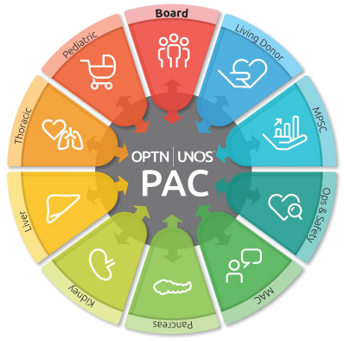
Constituent Councils
Public Comment:
  Don’t eliminate the committees, but expand the communications/connectivity tools
Limited proof of concept
  2 committees (PAC, TCC)
  Testing structure, tools
  July 1 - December 30
  Evaluate and recommend future proofs of concept
Notes:
In the spring, we let you know we would be launching this project with two Committees – PAC and TCC – and you’ll hear more from actual participants later on today.
We are testing a modified Committee structure by linking PAC and TCC reps on standing Committees with these “home” Committees in an effort to enable peer-to-peer dialogue and to amplify these perspectives within our governance structure
This phase of the project will conclude at the end of the calendar year; we will evaluate the project and look at ways we as a community can continue to encourage this kind of collaboration in future proofs of concept

Slide 16
Geography in Organ Allocation
Update

Slide 17
OPTN Final Rule
Policy development. The Board of Directors established under § 121.3 shall develop, in accordance with the policy development process described in § 121.4, policies for the equitable allocation of cadaveric organs among potential recipients. Such allocation policies:
(1) Shall be based on sound medical judgment;
(2) Shall seek to achieve the best use of donated organs;
(3) Shall preserve the ability of a transplant program to decline an offer of an organ or not to use the organ for the potential recipient in accordance with § 121.7(b)(4)(d) and (e);
(4) Shall be specific for each organ type or combination of organ types to be transplanted into a transplant candidate;
(5) Shall be designed to avoid wasting organs, to avoid futile transplants, to promote patient access to transplantation, and to promote the efficient management of organ placement;
(8) Shall not be based on the candidate’s place of residence or place of listing, except to the extent required by paragraphs (a)(1)-(5) of this section.
Notes:
Emphasize: there are other parts of the final rule to be considered; this is what we’re focusing on now.

Slide 18
Timeline
November 2017
    DSA removed from lung allocation policy
December 2017
    Ad Hoc Geography Committee formed
June 2018
  Critical comments sent to HHS regarding liver allocation
  Geography principles ratified by Board
  Executive Committee directs Liver Committee to amend liver policy to remove DSA/Region
July 2018
  Liver lawsuit filed
  HRSA letter to OPTN regarding DSA
  Two bills filed in Congress, one pro-sharing, one pro-local

Slide 19

Lung

Slide 20
Plaintiff’s Argument
Use of the DSA as the primary unit of lung distribution was arbitrary and capricious because:
      DSAs have no correlation to organ viability
      DSAs were not created for organ distribution
      DSAs are not consistent in size (geographically, population, patients waiting, donors, # of programs)
      Using DSAs results in wide variation
      Using DSAs results in allocation inconsistent with the mandates of the final rule
Notes:
Add why these terms are important

Slide 21
Executive Committee concluded that:
  Lung allocation policy contained an over-reliance on DSA as primary unit of allocation
  A revised policy that does not depend on DSA as primary unit of allocation of lungs is more consistent with Final Rule
  Replacing DSA with a 250-mile circle from donor hospital as first element of lung allocation is a reasonable geographic constraint
250-mile circle was implemented in November, subject to subsequent public comment, confirmed by Board of Directors in June

Slide 22

Liver

Slide 23
New Liver Policy – December 2017
Distribution to region + 150 mile circle for most urgent candidates
3 proximity points to candidates within the circle or DSA
Allocation to DSA for lower MELDs
Allocation to DSA for hard-to-place livers (DCD, > 70 yr)

Slide 24
May 30: Critical Comment to HHS
Letter to HHS Secretary received May 30, 2018
Same law firm that filed suit over lung policy
Argued that liver policy (using Regions and DSAs) is inconsistent with the Final Rule and challenges:
    Current liver policy
    Policy approved in December 2017
    Policy for the National Liver Review Board (NLRB) scoring of exception patients
Letter requests immediate action by the Secretary

Slide 25
June 8: HRSA Request to OPTN
HRSA Administrator seeks the OPTN’s views on whether the following aspects of the revised allocation policy are aligned with NOTA and the Final Rule:
Using DSAs as units of allocation
Using OPTN regions as units of allocation
Using proximity points in relation to DSAs
Using median MELD in DSAs in granting exceptions

Slide 26
June 25: OPTN Response to HRSA
Revised Liver Policy does not include an over-reliance on DSA due to prioritization of medically urgent candidates irrespective of location
Lung allocation policy first distributed exclusively in the DSA; revised Liver does not
OPTN reconfirms that DSAs/Regions are neither rationally determined nor consistently applied
OPTN commits to a multi-step plan to eliminate use of DSAs/Regions in liver distribution in a deliberative manner and within a timeframe that will reduce likelihood of unintended consequences
      i.e., organ discard, harm to patients

Slide 27
July 31: HRSA Response to OPTN
DSAs/regions not appropriate for organ distribution purposes
Continue on the path for December liver revisions
Develop a timetable for removing DSAs/regions from other organ policies
Report timetable to HRSA by August 13
Notes:
Address the other components of the Final Rule, but the distribution issue an immediate issue. Quote from letter on socioeconomic part of final rule?

Slide 28
Plan for All Organ Systems
Heart
Lung
Liver
Kidney
Pancreas
Small Intestine
VCA

Slide 29
OPTN Next Steps
The OPTN will release any available data or models for public discussion and feedback. In order to allow the Liver Committee time for careful review, this public discussion will likely take place in a special public comment period in October or November 2018.
Proposal for liver allocation system, without DSAs/regions, will go before the Board in December 2018.
The policy approved by the OPTN Board in December will be expeditiously implemented in the matching IT system.
Other organ-specific Committees will begin reviewing their allocation systems for DSA/region replacement for review at the June 2019 Board meeting.
Notes:
This is a high level, organizational overview - you will hear later today from the Geography and Liver Committees about their progress with this effort
The other organ-specific Committees have already begun meeting on this topic
IF ASKED:
The detailed timeline is available in the letter we sent HRSA on Aug.13 – this has been/will be made available to the community
We have informed HRSA that Kidney/Panc work group may need additional time given the results of modeling or other variables – but the current plan is to make a recommendation by the June 2019 Board
How can we ask Liver to adopt a framework while releasing 3 options for PC? (aka Reddy’s question from Board prep call). Similarly, will we need to quickly change the distribution policies as soon as the Board adopts a preferred distribution framework?
The broad purpose for a consistent framework is long term efficiency as opposed to addressing an imminent, legal risk. So we don't need to all switch to a consistent framework rapidly.
That said, we have a potential legal risk facing us right now by using DSAs and regions. That’s why we’ve charged all of the organ committees with moving toward one of the three frameworks.
Committees do, however, frequently making changes to the allocation policies. We are always going to have tweaks, and as we review data and make future changes, we’ll have a guidepost that all the committees can work toward.
For example, if cliffs are bad, we’ll all take a similar approach to smoothing out cliffs.
In any event, none of those can happen overnight so we will need to prioritize the work.

Slide 30
Future Geography Frameworks

Slide 31
Ad Hoc Committee on Geography
Formed in December 2017
Chairs or vice-chairs of organ specific committees, Transplant Administrators, OPO, and ethics
Several board members
AOPO, AST, ASTS representatives

Slide 32
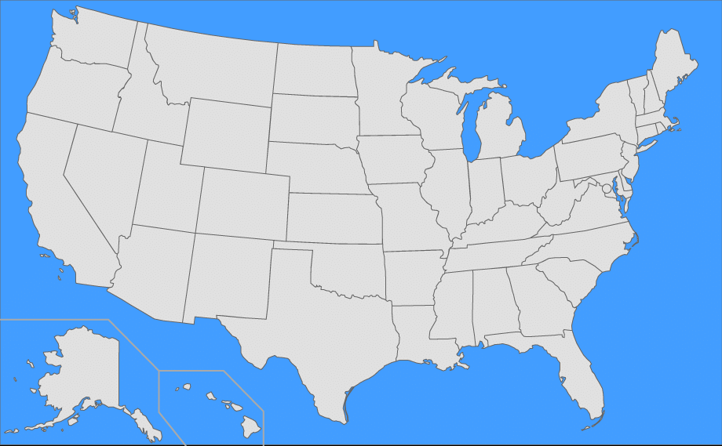

Ad Hoc Committee on Geography

Slide 33
Ad Hoc Committee on Geography
Charge
Establish defined guiding principles for the use of geographic constraints in organ allocation
Review and recommend frameworks/models for incorporating geographic principles into allocation policies
Identify uniform concepts for organ specific allocation policies in light of the requirements of the OPTN Final Rule
Notes:
As a reminder: The Committee charge is very clear and limited to discussions and recommendations.
The charge for the Ad Hoc Committee on Geography is to:
Establish defined guiding principles for the use of geographic constraints in organ allocation
Review and recommend frameworks/models for incorporating geographic principles into allocation policies
Identify uniform concepts for organ specific allocation policies in light of the requirements of the OPTN Final Rule
Principles to be used when defining geographic allocation units
Applied consistently and avoid creating constraints that inconsistently create arbitrary boundaries
Actions during Liver to gain input/develop trust: held town halls, repeat modeling, Miami meeting, board lunch discussion, and took calls and emails on the last proposal.
Support of the process rather than adding a member to the group would speak volumes in terms of trust

Slide 34
Principle of Distribution | Final Rule Requirement
Deceased donor organs are a national resource to be distributed as broadly as feasible | Final Rule §121.8(a) states, “... allocation policies: (8) Shall not be based on the candidate’s place of residence of listing ...” Final Rule §121.8(b) states, “Allocation policies shall be designed to achieve equitable allocation of organs among patients... through the following performance goals, (3) distributing organs over as broad a geographic area as feasible ...”
Reduce inherent differences in the ratio of donor supply and demand across the country | Final Rule §121.8(a) states, “... allocation policies: (5) Shall be designed to ... promote patient access to transplantation, and to promote the efficient management of organ placement.”
Reduce travel time expected to have a clinically significant effect on ischemic time and organ quality | Final Rule §121.8(a) states, “... allocation policies: (1) Shall be based on sound medical judgment; (5) Shall be designed to avoid wasting organs...”
Increase organ utilization and prevent organ wastage | Final Rule: §121.8(a) states, “... allocation policies: (5) Shall be designed to avoid wasting organs ...”
Increase efficiencies of donation and transplant system resources | Final Rule: §121.8(a) states, “... allocation policies: (5) Shall be designed to … promote the efficient management of organ placement...”

Slide 35
Geography Principles
Deceased donor organs are a national resource to be distributed as broadly as feasible. Any geographic constraints pertaining to the principles of organ distribution must be rationally determined and consistently applied to minimize the effect of geography on a candidate’s access to transplantation. Geographic distribution may be constrained in order to:
Reduce inherent difference the ration of donor supply and demand across the country
Reduce travel time expected to have a clinically significant effect on ischemic time and organ quality
Increase organ utilization and prevent organ wastage
Increase efficiencies of donation and transplant system resources

Slide 36
Geography Frameworks

Slide 37
Distribution Frameworks
Committee identified three distribution frameworks consistent with the Principles and the OPTN Final Rule
Committee seeks discussion and community feedback
  Goal: identify a single, preferred distribution framework to be used across all organs
Distribution Frameworks
  1. Fixed Distance from the Donor Hospital
  2. Mathematical Optimization
  3. Continuous Distribution
Notes:
The Committee also identified three frameworks for geographic distribution that it finds to be consistent with the principles and with the Final Rule. The Committee recommends further discussion by the Board and by the community of the merits of the three frameworks, but agrees that the system would be best served by adopting a single common framework to be applied to all organ allocation policies. Even within a common framework, each organ would have medically determined factors that apply specifically to that organ. The three frameworks identified by the Committee are:
Organ Distribution Based on Fixed Distance from the Donor Hospital
Organ Distribution Based on Mathematical Optimization
Continuous Distribution of Organs

Slide 38
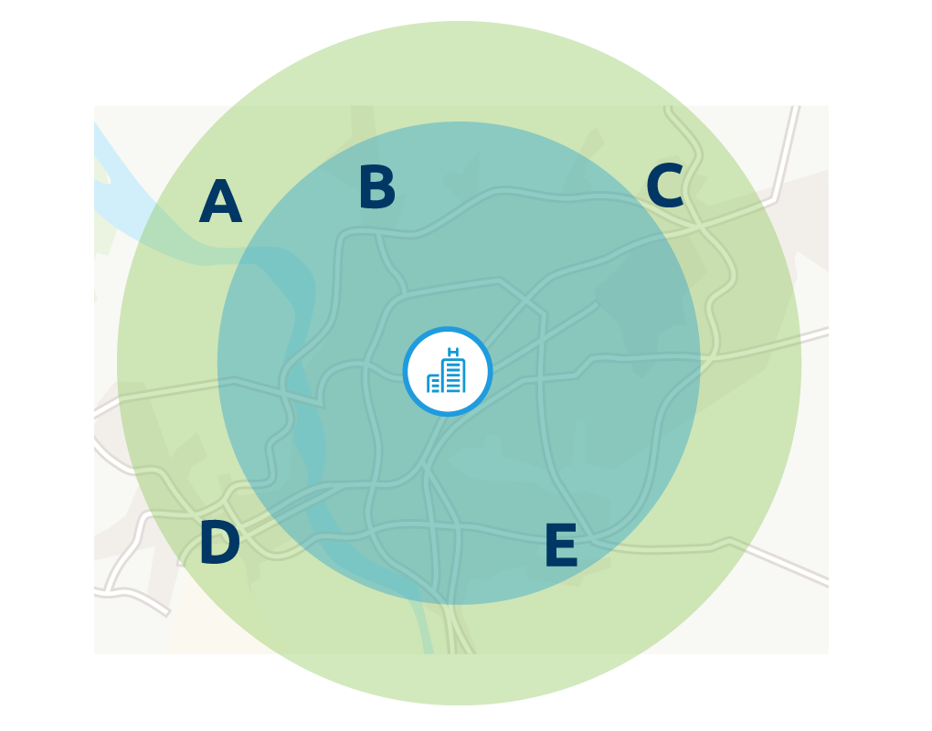
Fixed Distance from Donor Hospital
Advantages:
Easy to explain
Extends distribution area, particularly for medically urgent patients
Disadvantages:
Fixed boundaries
Differences in population density may affect patients with similar matching characteristics
Notes:
Illustrations, Animation and Kevin O’Connor video can be found at: https://transplantpro.org/policy/organ-distribution/
This framework creates fixed geographic areas based on the distance between the donor hospital and the transplant candidate’s hospital. While local matches may receive priority, this approach may also allow wider distribution for other characteristics such as medical urgency.
In this example, the donor hospital is located between and relatively close to transplant hospitals B and E. Candidates at hospitals B and E are within the first proximity circle. Candidates at transplant hospitals A, C and D are in a wider circle. If there are no major differences in urgency between candidates at any of the hospitals, the local candidates at hospitals B or E would appear on a match run before those in the wider circle. But if a candidate at hospital C is considerably sicker than any at hospital B or E, the system could prioritize that candidate ahead of more local candidates.
ADVANTAGES
Easy to explain
Allows you to consider organ-specific constraints such as travel time.
Extends distribution to a larger area – this means medically urgent patients across a broader area could receive an organ.
DISADVANTAGES
However the proximity is determined, it uses fixed boundaries. As a result, two candidates who have similar matching characteristics and level of medical urgency may be treated very differently because they fall in different zones, even though they may be just a few miles apart.
Also, there are differences in population density from one area of the country to another. This may mean that circles of the same size across the country could result in having a higher or lower number of potential candidates within the zones.

Slide 39
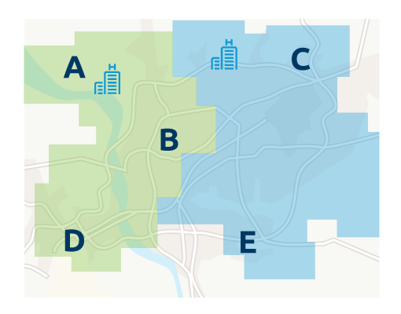
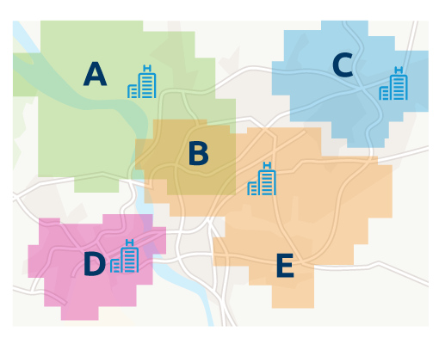
Mathematically Optimized Boundaries
Advantages
Provides consistent results
Can be monitored and scaled
Disadvantages
Boundaries may be complex and not uniform
Fixed boundaries
Limited number of large districts
Large number of localized neighborhoods
Notes:
Mathematical optimization can be used to establish distribution boundaries. The boundaries are based on a statistical formula designed to achieve the best results for one or more specific goals, such as having a consistent ratio of donors to potential recipients within each distribution area. Distribution areas could range from a limited number of large districts to a relatively large number of localized neighborhoods. Their shape could also be customized to account for unique issues of demographics, geography or clinical factors. Neighborhood boundaries could overlap if the factors used to calculate them share common characteristics, thus an individual transplant hospital may be in more than one neighborhood.
Limited number of large districts
In this example transplant hospitals A, B and D are in one distribution district, with hospitals C and E in a separate district.
Larger number of localized neighborhoods
Using a neighborhood approach, hospitals A and B and B and E are in common neighborhoods, while hospitals in C and D are in separate neighborhoods. Candidates at hospital B may thus appear as local matches in either neighborhood the hospital shares with A or E.
ADVANTAGES
Provides consistent results
Can be monitored and scaled according to objective criteria.
DISADVANTAGES
In order to account for differences in population or other characteristics, the boundaries may be complex and may not be as uniform in some areas of the country as they are in others.
This system establishes a fixed boundary - thus, it may treat two patients with similar medical needs and characteristics differently when they are local to each other but are listed at different hospitals that cross a boundary.

Slide 40
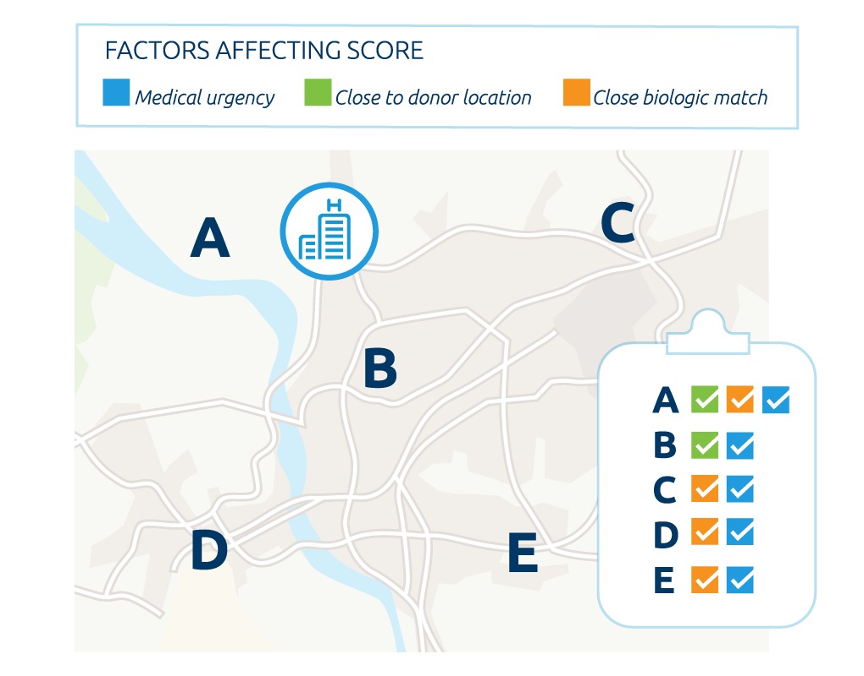
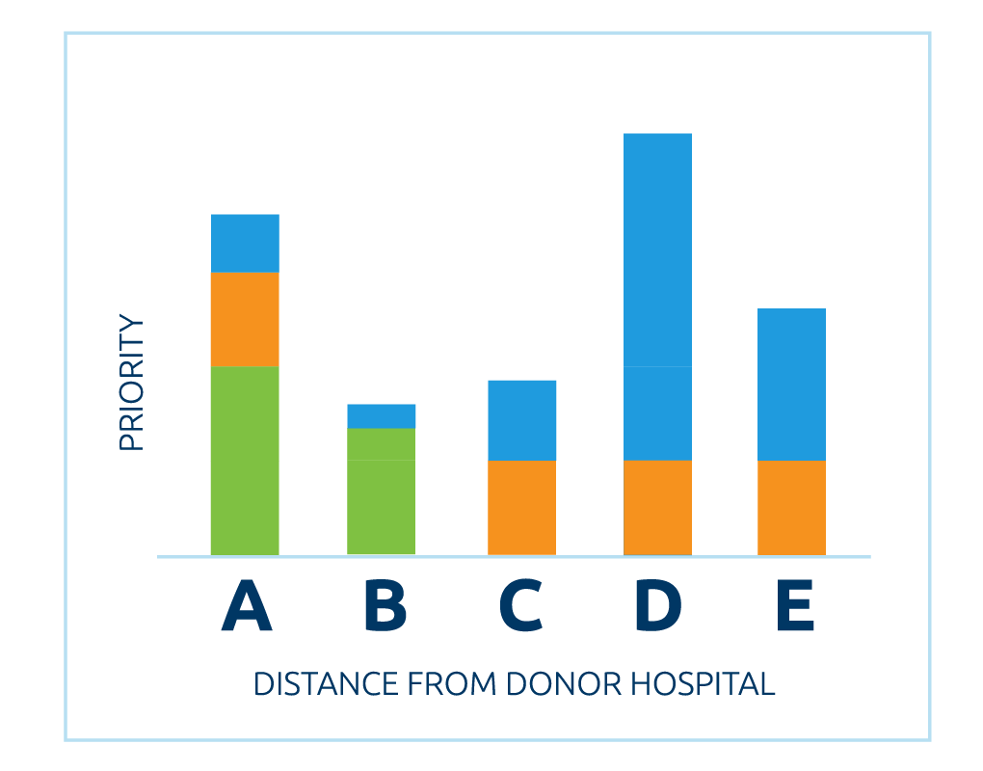
Continuous Distribution
Advantages
Two patients who are similar in suitability would be treated much the same way
Priority would consider specific clinical characteristics about the candidate
More likely that organ offers would be matched efficiently with candidates in highest medical need
Disadvantages
Less easy to understand and explain
Notes:
Organs can be distributed to candidates using a statistical formula that combines important clinical factors, such as medical urgency and likelihood of graft survival, along with proximity to the donor location. Using this approach, all candidates would receive a relative distribution score, but there would be no absolute geographic boundary. Candidates who best meet the combination of factors receive the highest priority.
No fixed boundaries
In this example, there are no fixed boundaries between transplant hospitals. The donor hospital is closest to Hospitals A and B, so candidates at those two hospitals receive some points for proximity. Hospitals A, C, D and E all have candidates who are a close biologic match. Hospitals D and E both have candidates with elevated medical urgency, with Hospital D having the most urgent candidate.
Combination of factors
When these various factors are combined, a candidate at Hospital D would appear first on the match. This candidate receives no proximity points but ranks strongly based on medical urgency and biologic compatibility. The candidate appearing next on the match is at Hospital A, with a combination of priority for proximity and biological compatibility. Candidates at the other three hospitals appear lower on the match according to how strongly they match on the combined factors.
ADVANTAGES
Without a specific boundary, two patients who are similar to each other in suitability and proximity would be treated much the same way.
The model used to calculate priority would consider specific clinical characteristics about the organ and the candidate - this would make it more likely that organ offers would be matched more efficiently with candidates, and that candidates in highest medical need may receive priority regardless of proximity to the donor hospital.
DISADVANTAGES
The formula may not be as easy to understand and explain.
.

Slide 41
Questions?

