Slide 1
UNOS Update
Maryl Johnson, MD
UNOS Vice President
Region 8
August 15, 2018

Slide 2
MISSION
Advance organ availability and transplantation by uniting and supporting our communities, including transplant and organ donation professionals, patients and donor and recipient families, for the benefit of patients through education, technology and policy development.
VISION
Promote long, healthy and productive lives for persons with organ failure by promoting maximized organ supply, effective and safe care, and equitable organ allocation and access to transplantation.
VALUES
Stewardship
Unity
Trust
Excellence
Accountability

Slide 3
In Organ Allocation

Slide 4
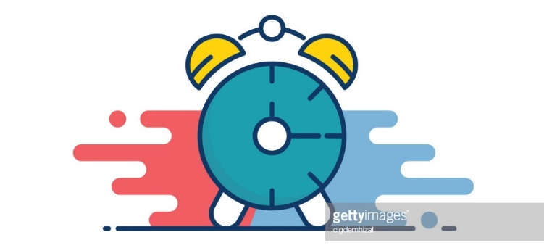
2017
November
DSA removed from lung allocation policy
December
Ad Hoc Geography Committee formed
2018
June
Critical comments sent to HHS regarding liver allocation
Geography principles ratified by Board
Executive Committee directs Liver Committee to amend liver policy to remove DSA/Region
July
Liver lawsuit filed
HRSA letter to OPTN regarding DSA
Timeline

Slide 5
OPTN Final Rule
Policy development. The Board of Directors established under § 121.3 shall develop, in accordance with the policy development process described in § 121.4, policies for the equitable allocation of cadaveric organs among potential recipients. Such allocation policies:
(1) Shall be based on sound medical judgment;
(2) Shall seek to achieve the best use of donated organs;
(3) Shall preserve the ability of a transplant program to decline an offer of an organ or not to use the organ for the potential recipient in accordance with § 121.7(b)(4)(d) and (e);
(4) Shall be specific for each organ type or combination of organ types to be transplanted into a transplant candidate;
(5) Shall be designed to avoid wasting organs, to avoid futile transplants, to promote patient access to transplantation, and to promote the efficient management of organ placement;
(8) Shall not be based on the candidate’s place of residence or place of listing, except to the extent required by paragraphs (a)(1)-(5) of this section.
Notes:
Emphasize: there are other parts of the final rule to be considered; this is what we’re focusing on now.

Slide 6
Plaintiff’s Argument
Use of the DSA as the primary unit of lung distribution was arbitrary and capricious because:
DSAs have no correlation to organ viability
DSAs were not created for organ distribution
DSAs are not consistent in size (geographically, population, patients waiting, donors, # of programs)
Using DSAs results in wide variation
Using DSAs results in allocation inconsistent with the mandates of the final rule
Notes:
Add why these terms are important

Slide 7
Lung

Slide 8
Executive Committee concluded that:
Lung allocation policy contained an over-reliance on DSA as primary unit of allocation
A revised policy that does not depend on DSA as primary unit of allocation of lungs is more consistent with Final Rule
Replacing DSA with a 250-mile circle from donor hospital as first element of lung allocation is a reasonable geographic constraint
250-mile circle was implemented in November, subject to subsequent public comment, confirmed by Board of Directors in June

Slide 9
Liver

Slide 10
New Liver Policy – December 2017
Distribution to region + 150 mile circle for most urgent candidates
3 proximity points to candidates within the circle or DSA
Allocation to DSA for lower MELDs
Allocation to DSA for hard-to-place livers (DCD, > 70 yr)

Slide 11
May 30: Critical Comment to HHS
Letter to HHS Secretary received May 30, 2018
Same law firm that filed suit over lung policy
Argued that liver policy (using Regions and DSAs) is inconsistent with the Final Rule and challenges:
Current liver policy
Policy approved in December 2017
Policy for the National Liver Review Board (NLRB) scoring of exception patients
Letter requests immediate action by the Secretary

Slide 12
June 8: HRSA Request to OPTN
HRSA Administrator seeks the OPTN’s views on whether the following aspects of the revised allocation policy are aligned with NOTA and the Final Rule:
Using DSAs as units of allocation
Using OPTN regions as units of allocation
Using proximity points in relation to DSAs
Using median MELD in DSAs in granting exceptions

Slide 13
June 25: OPTN Response to HRSA
Revised Liver Policy does not include an over-reliance on DSA due to prioritization of medically urgent candidates irrespective of location
Lung allocation policy first distributed exclusively in the DSA; revised Liver does not
OPTN reconfirms that DSAs/Regions are neither rationally determined nor consistently applied
OPTN commits to a multi-step plan to eliminate use of DSAs/Regions in liver distribution in a deliberative manner and within a timeframe that will reduce likelihood of unintended consequences
i.e., organ discard, harm to patients

Slide 14
July 31: HRSA Response to OPTN
DSAs/regions not appropriate for organ distribution purposes
Continue on the path for December liver revisions
Develop a timetable for removing DSAs/regions from other organ policies
Report timetable to HRSA by August 13
Notes:
Address the other components of the Final Rule, but the distribution issue an immediate issue. Quote from letter on socioeconomic part of final rule?

Slide 15
Plan for All Organ Systems
Heart
Lung
Liver
Kidney
Pancreas
Small Intestine
VCA

Slide 16
OPTN Next Steps
The OPTN will release any available data or models for public discussion and feedback. In order to allow the Liver Committee time for careful review, this public discussion will likely take place in a special public comment period in October or November 2018.
Proposal for liver allocation system, without DSAs/regions, will go before the Board in December 2018.
The policy approved by the OPTN Board in December will be expeditiously implemented in the matching IT system.
Other organ-specific Committees will begin reviewing their allocation systems for DSA/region replacement for review at the June 2019 Board meeting.
Notes:
This is a high level, organizational overview - you will hear later today from the Geography and Liver Committees about their progress with this effort
The other organ-specific Committees have already begun meeting on this topic
IF ASKED:
The detailed timeline is available in the letter we sent HRSA on Aug.13 – this has been/will be made available to the community
We have informed HRSA that Kidney/Panc work group may need additional time given the results of modeling or other variables – but the current plan is to make a recommendation by the June 2019 Board
How can we ask Liver to adopt a framework while releasing 3 options for PC? (aka Reddy’s question from Board prep call). Similarly, will we need to quickly change the distribution policies as soon as the Board adopts a preferred distribution framework?
The broad purpose for a consistent framework is long term efficiency as opposed to addressing an imminent, legal risk. So we don't need to all switch to a consistent framework rapidly.
That said, we have a potential legal risk facing us right now by using DSAs and regions. That’s why we’ve charged all of the organ committees with moving toward one of the three frameworks.
Committees do, however, frequently making changes to the allocation policies. We are always going to have tweaks, and as we review data and make future changes, we’ll have a guidepost that all the committees can work toward.
For example, if cliffs are bad, we’ll all take a similar approach to smoothing out cliffs.
In any event, none of those can happen overnight so we will need to prioritize the work.

Slide 17
OPTN/UNOS Ad Hoc Committee on Systems Performance
August 2018-March 2019

Slide 18
Ad Hoc Committee on Systems Performance
Systems Performance Committee
Diane Brockmeier
Matt Cooper
Systems Dynamics Work Group
Jeff Orlowski, Stuart Sweet
OPO Work Group
Susan Gunderson, Tom Pearson
Transplant Program Work Group
Lisa Stocks, Alan Reed
Objective:
Identify and prioritize new and existing tools and strategies that allow the OPTN, transplant hospitals, and OPOs to drive improved system performance and collaborative improvement.

Slide 19
Committee Details & Potential Outcomes
55 community members
Three Work Groups
2 Co-Chairs per Work Group (1 Transplant MD, 1 OPO)
Work Groups will meet monthly August-March
October in-person
Public meeting in March in Chicago (Date TBD)
MPSC monitoring enhancements
Recommendations to external stakeholders
Collaborative improvement project ideas
Suggested new research tools

Slide 20
OPTN/UNOS Governance Structure: How to Volunteer Board, Committees, Regions
Notes:
We’ve had a number of questions lately about how to be considered for a Board, Committee or Regional volunteer position
This is a brief, high level overview of the process – if you have follow up questions or want to know more about a particular position, I encourage you to reach out to UNOS staff to discuss the details

Slide 21
Volunteer Opportunities
Notes:
We work hard to ensure our volunteer perspectives come from a variety of professional disciplines, personal experience and expertise in organ transplantation and the community we serve
The overall composition of the committees and Board must reflect diversity in perspectives as well as race, ethnicity, and gender—plus specific committee needs for specialized expertise
Volunteering in the governance structure is not for everyone; takes commitment, deep experience
And not everyone can be on a committee…there’s a limited number of positions available
So while there are 350 total seats, only approximately 110 open each year, and we have strict criteria for filling those seats…

Slide 22
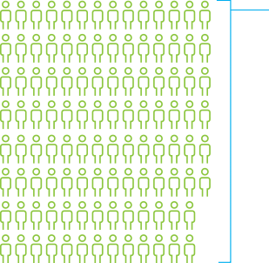
OPTN Bylaws
Notes:
Board and Committee composition is governed in part by the final rule and our own OPTN Bylaws
And we must reflect the diversity of the community we serve – not only ethnicity and gender, which are important, but different areas of practice, different professions within the field of transplant, and different sizes of transplant programs and OPOs
In order to ensure we’re compliant with the final rule and Bylaws requirements, we conduct an annual Board and Committees needs assessment prior to doing a call for nominations
The process is somewhat different for committee, regional, and Board openings. But in each case we’re intentional about seeing what the needs are and searching for motivated, experienced candidates to meet those needs.

Slide 23
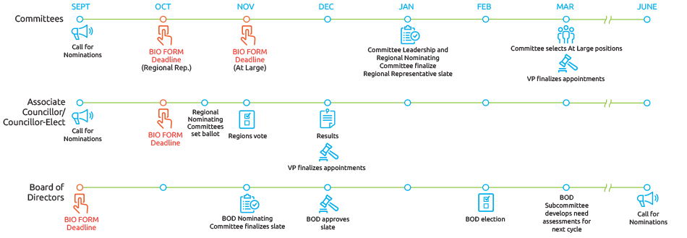
Governance Volunteer Positions: How to Apply
Notes:
Again, this is a high level overview of the process for volunteering for the Board, Committees and Regions.
The key takeaway here is that the OPTN/UNOS Bio Form is the key to serving on the Committee
Selections are based on needs of committee and the organization for diversity in perspectives and subject specific expertise
The OPTN/UNOS President-Elect ultimately reviews and approves all incoming committee members
The call for nominations for the 2019-2020 term is in your booklets, so please review that for all relevant details, including submission deadlines

Slide 24
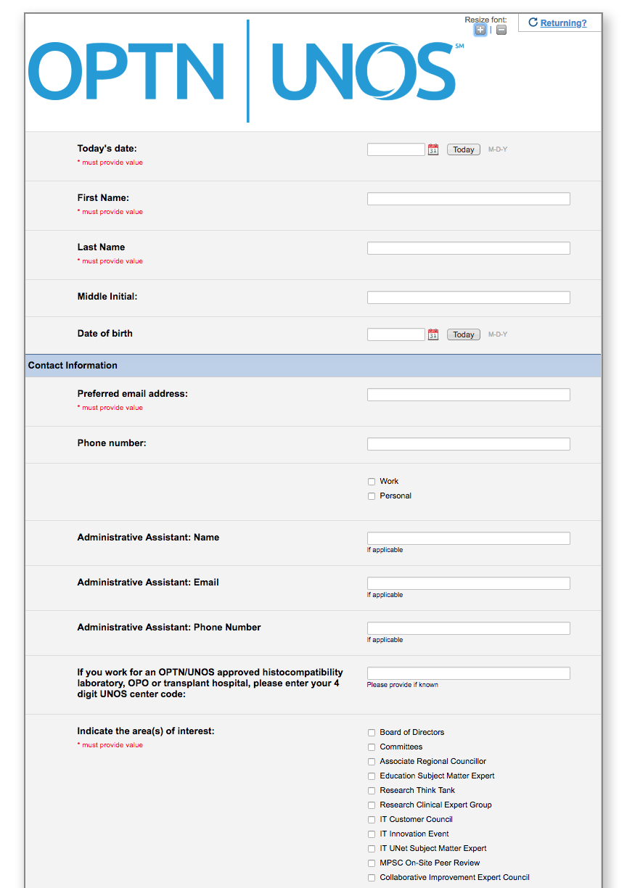
OPTN/UNOS Bio Form
Update your form annually to be considered for governance volunteer positions
http://optn.transplant.hrsa.gov/
Members > Get Involved
Notes:
The form is accepted on a rolling basis year-round, but you must submit one by the deadlines above to be considered within the upcoming cycle
Be sure to update your biography form annually to show your continued interest
Each committee with openings will review biography forms and make recommendations
Keeping your form updated will also ensure your name is available to UNOS staff in the event a vacancy needs to be filled mid-cycle due to resignations or moves
We also encourage professionals to refer recipients, donors and donor families to this form if you think they’d be well suited for Committee service

Slide 25
Brought to you by the MPSC

Slide 26
MPSC Lessons Learned
Reporting late-breaking donor test results (15.4.A) | PDF in UNOS Connect: "Reporting Patient Safety Events"
Disease transmission and labelling (15.4.A, 16.3.C, 16.3.F, 16.5, 16.6.A) | Learning Series in UNOS Connect: PHS and Disease Transmission
Living donation: evaluating donors, reporting living donor events (14.4.A, 18.6) | Reference card distributed at Living Donor Conference: "How to avoid the most common living donor policy violations"
ABO verification (5.8.B) | UNOS Connect: Education on new ABO Verification Policy
DCD Protocols (2.15.B) | Transplant Pro article: "OPO site survey process evolving and improving"

Slide 27
Constituent Council Proof of Concept
Summer/Fall 2018 Update
Notes:
Our last update today is a high-level overview of where we are with the constituent council proof of conce.pt

Slide 28
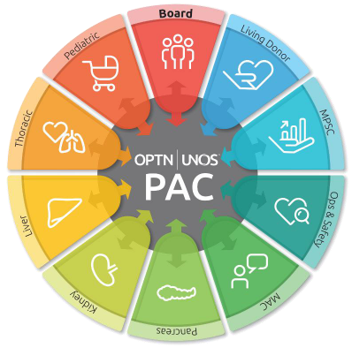
Constituent Councils
Connect constituent Committees with representatives on other committees
Enable peer-to-peer dialogue
Limited proof of concept
2 committees (PAC, TCC)
Testing structure, tools
July 1 - December 30
Evaluate and recommend future proofs of concept
Notes:
In the spring, we let you know we would be launching this project with two Committees – PAC and TCC – and you’ll hear more from actual participants later on today.
We are testing a modified Committee structure by linking PAC and TCC reps on standing Committees with these “home” Committees in an effort to enable peer-to-peer dialogue and to amplify these perspectives within our governance structure
This phase of the project will conclude at the end of the calendar year; we will evaluate the project and look at ways we as a community can continue to encourage this kind of collaboration in future proofs of concept

Slide 29
UNOS Update

